Slide 1
Visualizing Radio Waves

Slide 2
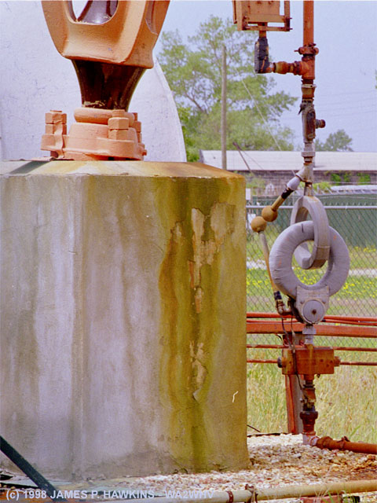
What is this?

Slide 3
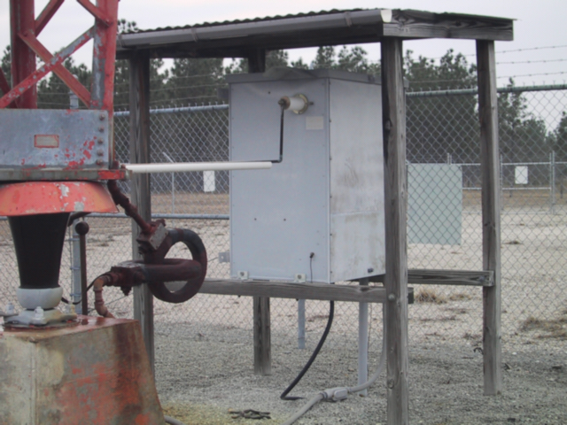
Austin Rings Mystery
117 V isolation transformer

Slide 4
Austin Rings Mystery
117 V isolation transformer
Secondary
Primary

Slide 5
Secondary
Primary

Slide 6
Secondary
Primary
Primary turns wound around toroidal core

Slide 7
Secondary
Primary
The turns of the secondary are this diameter.
Primary turns wound around toroidal core

Slide 8
Secondary
Primary
The turns of the secondary are this diameter.
No core in here.
Primary turns wound around toroidal core

Slide 9
Secondary
Primary
The turns of the secondary are this diameter.
No core in here.
Primary turns wound around toroidal core
the core for both is this

Slide 10
(secondary turns)
magnetic flux is within core
(primary turns)

Slide 11
(secondary turns)
magnetic flux is within core
(primary turns)
If the changing magnetic flux is contained within the core…
what in heaven’s name carries the power out to the secondary?

Slide 12
(secondary turns)
There is nothing you can place in this area which would reveal a field.
magnetic flux is within core
(primary turns)
If the changing magnetic flux is contained within the core…
what in heaven’s name carries the power out to the secondary?

Slide 13
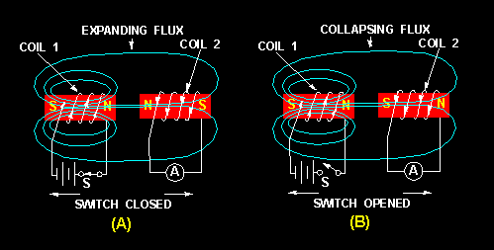
How We Were Taught
That a field expands around and collapses around the coil.

Slide 14
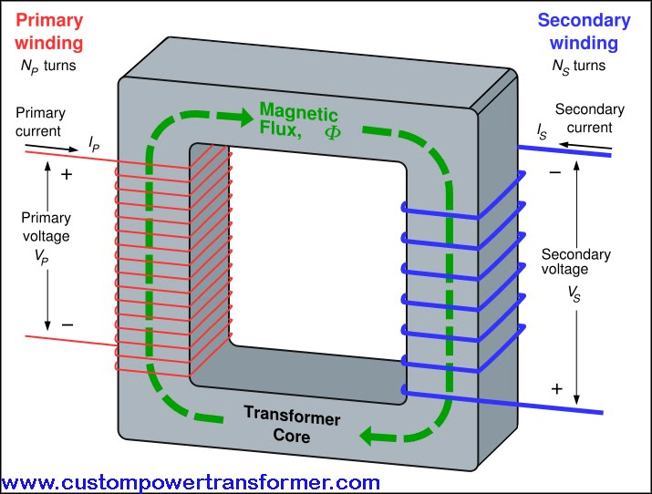
If the changing magnetic flux is contained within the core…
what in heaven’s name carries the power out to the secondary?

Slide 15
It’s not so obvious, but even when close wrapped, the flux does not touch any of the wire.
If the changing magnetic flux is contained within the core…
what in heaven’s name carries the power out to the secondary?

Slide 16
It’s not so obvious, but even when close wrapped, the flux does not touch any of the wire.
If the changing magnetic flux is contained within the core…
what in heaven’s name carries the power out to the secondary?

Slide 17
Answer…
If the changing magnetic flux is contained within the core…
what in heaven’s name carries the power out to the secondary?

Slide 18
Answer…
If the changing magnetic flux is contained within the core…
what in heaven’s name carries the power out to the secondary?

Slide 19
Answer…
a circulating electric field
If the changing magnetic flux is contained within the core…
what in heaven’s name carries the power out to the secondary?

Slide 20
Answer…
a circulating electric field
something rarely taught

Slide 21
Answer…
a circulating electric field
something rarely taught
It is a special kind of E field, an E-field that doesn’t radiate.

Slide 22
Answer…
a circulating electric field
something rarely taught
It is a special kind of E field, an E-field that doesn’t radiate. It has curl and no divergence.

Slide 23
A
Any attempt to measure this kind of electric field with an antenna
would fail.

Slide 24
A
Any attempt to measure this kind of electric field with an antenna
would fail.

Slide 25
A
Any attempt to measure this kind of electric field with an antenna
would fail.
Unless…

Slide 26
A
Any attempt to measure this kind of electric field with an antenna
would fail.
Unless…

Slide 27
A
Any attempt to measure this kind of electric field with an antenna
would fail.
Unless…
the measurement involves going through the opening.

Slide 28
A
Any attempt to measure this kind of electric field with an antenna
would fail.
Unless…
the measurement involves going through the opening.

Slide 29
A
Any attempt to measure this kind of electric field with an antenna
would fail.
Unless…
the measurement involves going through the opening.

Slide 30
A
Any attempt to measure this kind of electric field with an antenna
would fail.
Unless…
the measurement involves going through the opening.
Efficiency is not affected by the looseness of the wind.

Slide 31
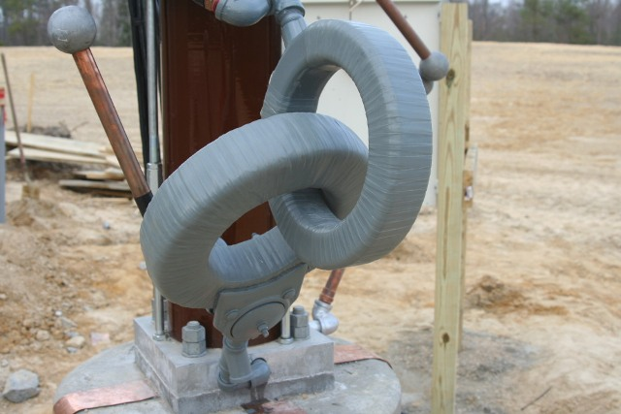
Austin Rings mystery shows how poor our models are.

Slide 32
Austin Rings mystery shows how poor our models are.
Models seem to have as their purpose, an aid to explain the math.

Slide 33
Austin Rings mystery shows how poor our models are.
Models seem to have as their purpose, an aid to explain the math.
That the E-field can circulate and few teachers explain when and why.

Slide 34
Austin Rings mystery shows how poor our models are.
Models seem to have as their purpose, an aid to explain the math.
That the E-field can circulate and few teachers explain when and why.
That the fields do not collapse around a coil, they just get stronger and weaker

Slide 35
The Fields of a Transformer are not Radiating Fields

Slide 36
The Fields of a Transformer are not Radiating Fields
A
nothing

Slide 37
The Fields of a Transformer are not Radiating Fields
A
The magnetic field is
entirely contained in the core
nothing

Slide 38
The Fields of a Transformer are not Radiating Fields
electric field
A
The magnetic field is
entirely contained in the core
nothing

Slide 39
The Fields of a Transformer are not Radiating Fields
electric field
A
The magnetic field is
entirely contained in the core
nothing

Slide 40
The Fields of a Transformer are not Radiating Fields
The electric field is the kind that circulates
electric field
A
The magnetic field is
entirely contained in the core
nothing

Slide 41
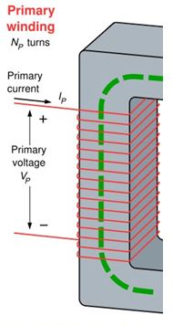
The Fields of a Transformer are not Radiating Fields
magnetic field
electric field

Slide 42
The Fields of a Transformer are not Radiating Fields
magnetic field
electric field
If there’s no load on the secondary, the primary has high impedance. It becomes a choke.

Slide 43
The Fields of a Transformer are not Radiating Fields
magnetic field
electric field
air core choke
If there’s no load on the secondary, the primary has high impedance. It becomes a choke.

Slide 44
The Fields of a Transformer are not Radiating Fields

Slide 45
The Fields of a Transformer are not Radiating Fields

Slide 49
A

Slide 50
A
Can now be used to couple with the field

Slide 51
And Now: Radiating Fields
A
Can now be used to couple with the field

Slide 52
And Now: Radiating Fields
A
Can now be used to couple with the field
A radiating field sends away power, whether there is a load there or not.

Slide 53
And Now: Radiating Fields
A
Can now be used to couple with the field
Fraunhofer Region

Slide 54
And Now: Radiating Fields
Fresnel Region
A
Can now be used to couple with the field
Fraunhofer Region

Slide 55
electric field
A
Can now be used to couple with the field
Fresnel Region
Fraunhofer Region

Slide 56
Radiating Fields

Slide 57
Radiating Fields
The Most Important Difference:
If there’s no receiver for the EM wave the power is radiated anyway.

Slide 58
Radiating Fields
The Most Important Difference:
If there’s no receiver for the EM wave the power is radiated anyway.
Whereas for the transformer, if there’s no load the power doesn’t come out.

Slide 59
Radiating Fields
The Most Important Difference:
If there’s no receiver for the EM wave the power is radiated anyway.
Whereas for the transformer, if there’s no load the power doesn’t come out.
Tesla was hoping there was a way to have both.

Slide 60
Radiating Fields
Fields do not collapse and expand,
they just get stronger and weaker.

Slide 61
Radiating Fields
Fields do not collapse and expand,
they just get stronger and weaker.
There is nothing that “flows” in spite of the word “flux”.

Slide 62
Sound Waves in a Solid

Slide 63
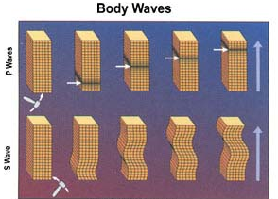
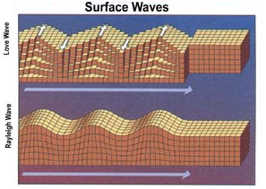
Sound Waves in a Solid

Slide 64
Sound Waves in a Solid
Compression Wave

Slide 65
Sound Waves in a Solid
Shear Wave

Slide 66
Sound Waves in a Solid
There’s any number of orientations the “S” wave can move.

Slide 67
Sound Waves in a Solid
There’s any number of orientations the “S” wave can move.

Slide 68
Sound Waves in a Solid
activity is →
but energy goes
There’s any number of orientations the “S” wave can move.

Slide 69
Sound Waves in a Solid
measurable
intensity
There’s any number of orientations the “S” wave can move.
Notes:
When viewed from the point of view of the power in the shaking, there are only 180° span of unique directions.

Slide 70
Sound Waves in a Solid
not
measurable
intensity
There’s any number of orientations the “S” wave can move.
Notes:
When viewed over the briefest of times, the are 360° of unique directions.
You will see this 360°, 180° thing again later.
For now just remember that the orientation of that which is measurable in the waves is unique only over 180°.
and that which is unique over 360° will for now be nameless.

Slide 71
Sound Waves in a Solid
this is polarization
There’s any number of orientations the “S” wave can move.

Slide 72
Sound Waves in a Solid
polarization is only possible
if vibrating transversely

Slide 73
Sound Waves in a Solid
polarization is only possible
if vibrating transversely
Fields do not collapse and expand,
they just get stronger and weaker.

Slide 74
Sound Waves in a Solid

Slide 75
Sound Waves in a Liquid

Slide 76
Cannot Support Polarization
Sound Waves in a Liquid

Slide 77
Cannot Support Polarization
Sound Waves in a Liquid

Slide 78
Cannot Support Polarization
Sound Waves in a Liquid
A liquid cannot support a force called a “shear force.

Slide 79
Cannot Support Polarization
Sound Waves in a Liquid

Slide 80
Cannot Support Polarization
Longitudinal Waves
Sound Waves in a Liquid

Slide 81
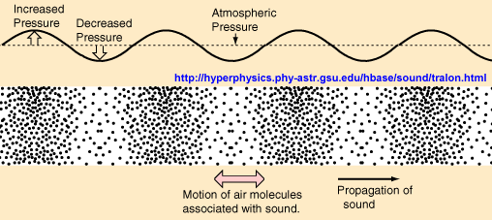
Longitudinal Waves

Slide 82
Longitudinal Waves

Slide 83
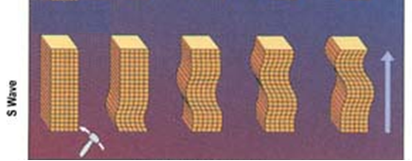
Transverse Waves Do Support Polarization
activity is →
but energy goes

Slide 84
Transverse Waves Do Support Polarization
activity is →
but energy goes
the medium has to be
rigid to support polarization
it has to be able transmit a shear force

Slide 85
Transverse Waves Do Support Polarization
the medium has to be
rigid to support polarization
it has to be able transmit a shear force
Notes:
Here’s our first view of an electromagnetic wave.

Slide 86
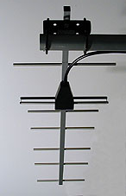
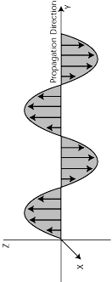
Transverse Waves Do Support Polarization
the medium has to be
rigid to support polarization
it has to be able transmit a shear force
Notes:
Here’s our first view of an electromagnetic wave.

Slide 87
Electric Waves Have Polarization
Therefore they must be:
the medium has to be
rigid to support polarization
it has to be able transmit a shear force
Notes:
Swing the rotating source

Slide 88
Electric Waves Have Polarization
Therefore they must be:
transverse and
the medium has to be
rigid to support polarization
it has to be able transmit a shear force

Slide 89
Electric Waves Have Polarization
Therefore they must be:
transverse and
travel through something rigid
the medium has to be
rigid to support polarization
it has to be able transmit a shear force

Slide 90
Electric Waves Have Polarization
Therefore they must be:
transverse and
travel through something rigid
energy is not because of motion
energy gets stronger and weaker
the medium has to be
rigid to support polarization
it has to be able transmit a shear force

Slide 91
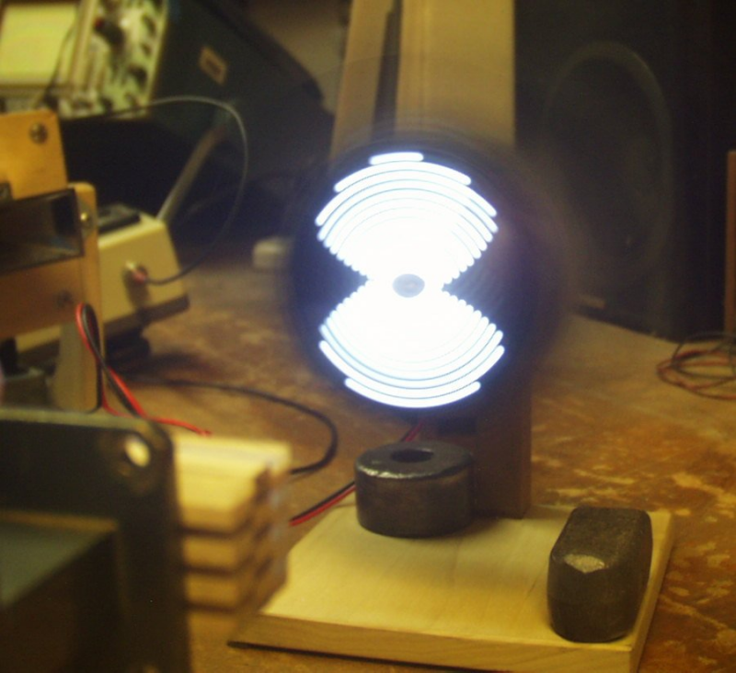
demo

Slide 92
The Spinning Bargraph Shows What an EM Wave Looks Like Rotationally

Slide 93
The Spinning Bargraph Shows What an EM Wave Looks Like Rotationally
Now for a Longitudinal View

Slide 94
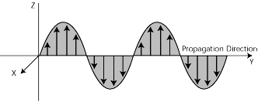
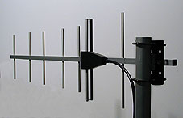
An EM wave is said to be transverse

Slide 95
An EM wave is said to be transverse
this does not mean that something has to move transversely

Slide 96
An EM wave is said to be transverse
this does not mean that something has to move transversely
it exists in a dimension that is transverse to its direction

Slide 97
An EM wave is said to be transverse
this does not mean that something has to move transversely
it exists in a dimension that is transverse to its direction
it gets weaker and stronger

Slide 98
An EM wave is said to be transverse
this does not mean that something has to move transversely
it exists in a dimension that is transverse to its direction
it gets weaker and stronger
this construct is used because it is so hard to show something that gets weaker and stronger

Slide 99
An EM wave is said to be transverse
this does not mean that something has to move transversely
it exists in a dimension that is transverse to its direction
it gets weaker and stronger
units are V / cm
this construct is used because it is so hard to show something that gets weaker and stronger

Slide 100
An EM wave is said to be transverse
this does not mean that something has to move transversely
it exists in a dimension that is transverse to its direction
it gets weaker and stronger
units are V / cm
this construct is used because it is so hard to show something that gets weaker and stronger
The length of the sensing element has nothing to do with the extent of the wave.

Slide 101
An EM wave is said to be transverse
this does not mean that something has to move transversely
it exists in a dimension that is transverse to its direction
it gets weaker and stronger
units are V / cm
where this unit has a “direction”

Slide 102
Fills space with an infinitely fine grain
another way to view it
units are V / cm
where this unit has a “direction”

Slide 103
Fills space with an infinitely fine grain
another way to view it
this way: nothing
units are V / cm
where this unit has a “direction”

Slide 104
Fills space with an infinitely fine grain
another way to view it
this way: nothing
horizontal
units are V / cm
where this unit has a “direction”

Slide 105
Fills space with an infinitely fine grain array of batteries
another way to view it
horizontal
units are V / cm

Slide 106
Fills space with an infinitely fine grain array of batteries
another way to view it
horizontal
units are V / cm

Slide 107
Fills space with an infinitely fine grain array of batteries
units are V / cm

Slide 108
Fills space with an infinitely fine grain array of batteries
units are V / cm

Slide 109
Fills space with an infinitely fine grain array of batteries
To visualize this we need to “strobe” it.
units are V / cm

Slide 110
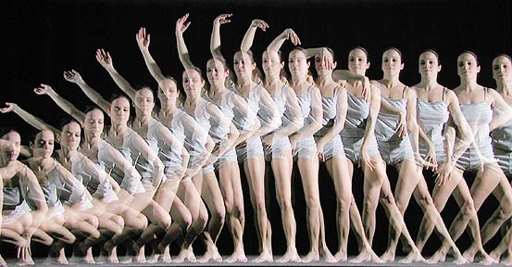
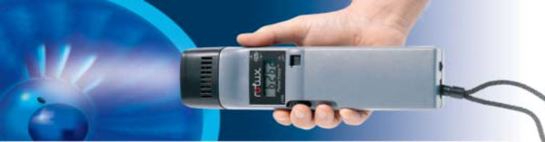
Stroboscope

Slide 111
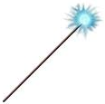
source

Slide 112
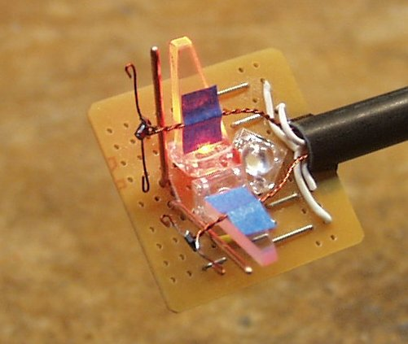
source

Slide 113
source

Slide 114
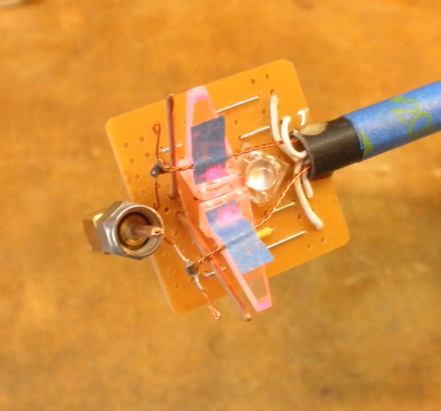
source

Slide 115
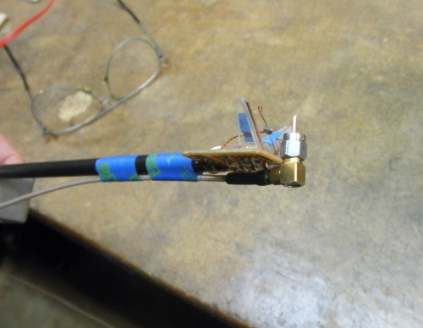
source

Slide 116
source

Slide 117
source

Slide 118
source

Slide 119
source

Slide 120
source

Slide 121
source

Slide 122
source

Slide 123
source

Slide 124
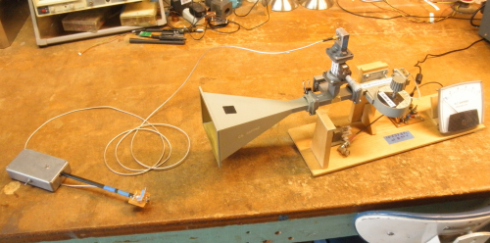

Slide 125
The Basic Interferometer
source
detector

Slide 126
The Basic Interferometer
mirror
partial
mirror
moving
mirror
source
detector

Slide 127
path 1
source
detector

Slide 128
source
path 2
detector

Slide 129
path 1
source
path 2
detector

Slide 130
source
detector

Slide 131
source
from fixed mirror
from moving mirror

Slide 132
source
detector

Slide 133
source
detector

Slide 134
source
detector

Slide 135
source
detector

Slide 136
source
detector

Slide 137
source
detector

Slide 138
source
detector

Slide 139
source
detector

Slide 140
source
detector

Slide 141
source
detector

Slide 142
source
detector

Slide 143
source
(both waves are moving)
detector

Slide 144
source
detector

Slide 145
source
detector

Slide 146
source
detector

Slide 147
source
detector

Slide 148
source
detector

Slide 149
source
detector

Slide 150
source
detector

Slide 151
source
detector

Slide 152
source
detector

Slide 153
source
detector

Slide 154
source
detector

Slide 155
source
detector

Slide 156
source
detector

Slide 157
source
detector

Slide 158
source
detector

Slide 159
source
detector

Slide 160
source
detector

Slide 161
source
detector
it doesn’t matter where our detector is

Slide 162
source
detector
it doesn’t matter where our detector is

Slide 163
source
it doesn’t matter where our detector is
detector

Slide 164
source
detector

Slide 165
source
detector

Slide 166
source
detector

Slide 167
source
detector

Slide 168
source
detector

Slide 171
source
detector

Slide 172
source
detector
any object

Slide 173
improved
source
detector

Slide 174
improved
source
detector

Slide 175
improved
source
more sensitive because no limit on the power
detector

Slide 176
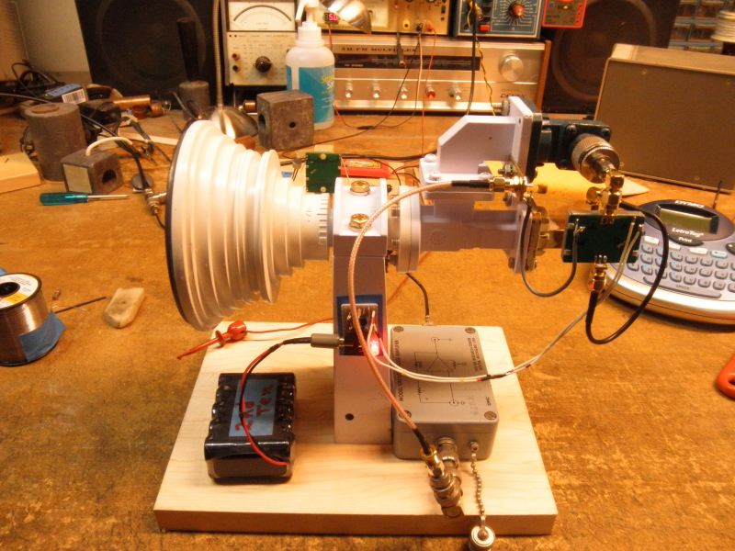
Interferometer

Slide 177
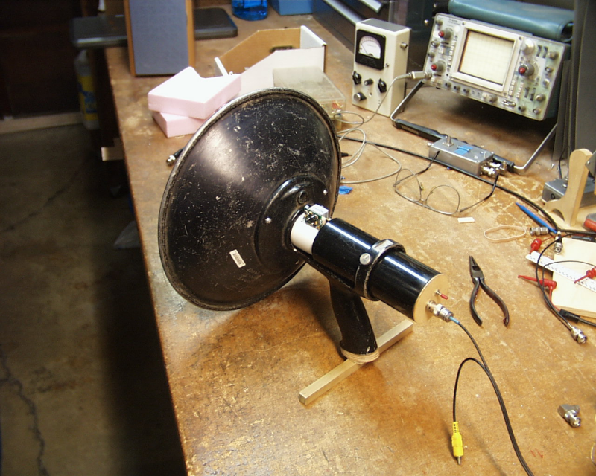
Motion Sensor

Slide 178
end

Slide 179
Electric Waves Have Polarization
Therefore they must be:
transverse and
travel through something rigid
energy is not because of motion
compels one to believe in an electrically rigid medium.
the medium has to be
rigid to support polarization
it has to be able transmit a shear force
Notes:
I remember my fellow students were awfully eager to give up a belief in aether.
I tell you what I don’t believe in …Michelson-Morley

Slide 180
Electric Waves Have Polarization
Therefore they must be:
transverse and
travel through something rigid
energy is not because of motion
compels one to believe in an aether.
the medium has to be
rigid to support polarization
it has to be able transmit a shear force
Notes:
I remember my fellow students were awfully eager to give up a belief in aether.
I tell you what I don’t believe in …Michelson-Morley

