Slide 1
How To Adapt Satellite Dish Hardware to
Monitor Airliner Radar Altimeters
cheap

Slide 2
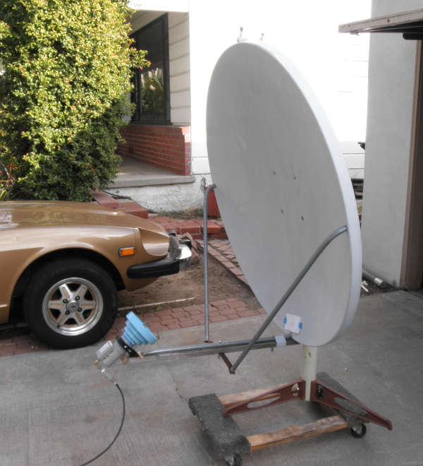
3,400 to 4,200 MHz (C-band)

Slide 3
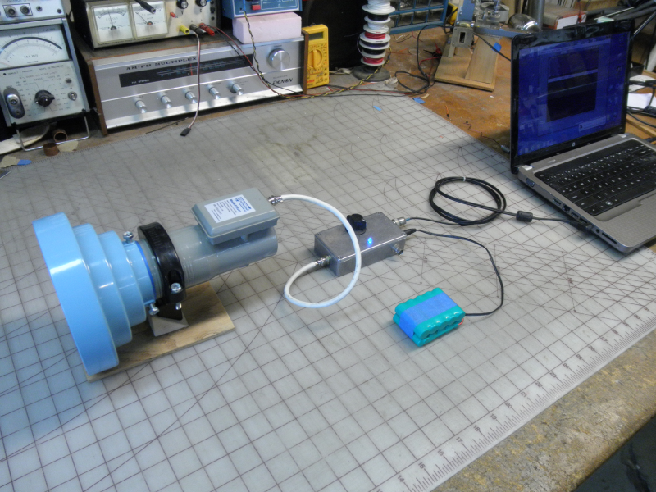
You don’t need a dish for ranges less than 4 miles.
3,400 to 4,200 MHz (C-band)

Slide 4
But you will need these.
You don’t need a dish for ranges less than 4 miles.
3,400 to 4,200 MHz (C-band)

Slide 5
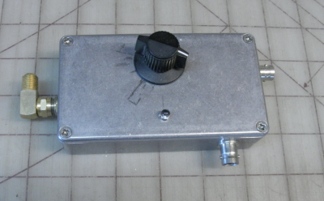
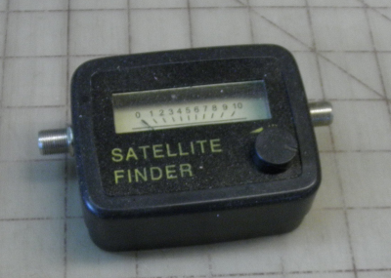
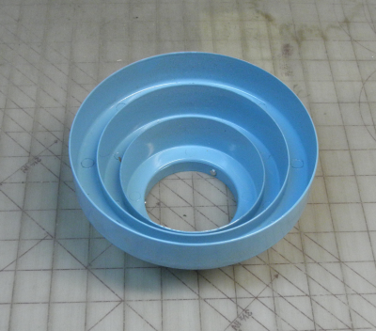
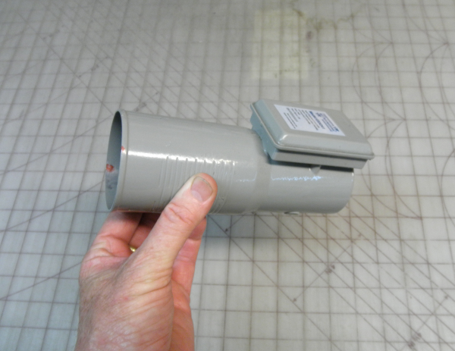
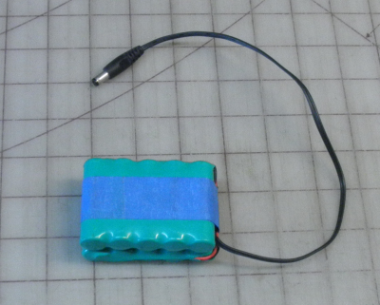
needs modification
“Sat Finder”
repackage (optional)
Horn
LNB
12 V Battery

Slide 6
needs modification
$10
http://www.ebay.com then keyword: “satellite finder”
repackage (optional)
$16
$23
$16
http://www.satpro.tv/conical-scalar-ring-c-band-lnb-bracket.aspx
http://www.satpro.tv/single-output-c-band-lnb.aspx
http://www.all-battery.com/12v2000mahnimhbatterypack11606.aspx

Slide 7
needs modification
$10
http://www.ebay.com then keyword: “satellite finder”
repackage (optional)
You need to disable the low pass filter.

Slide 8
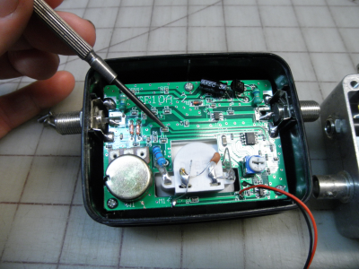
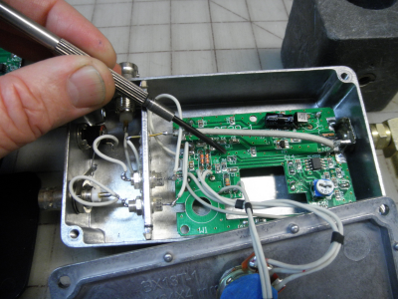
repackage (optional)
remove C12
You need to disable the low pass filter.

Slide 9
repackage (optional)
remove C12
You need to disable the low pass filter.
(Re-packaging optional)

Slide 10
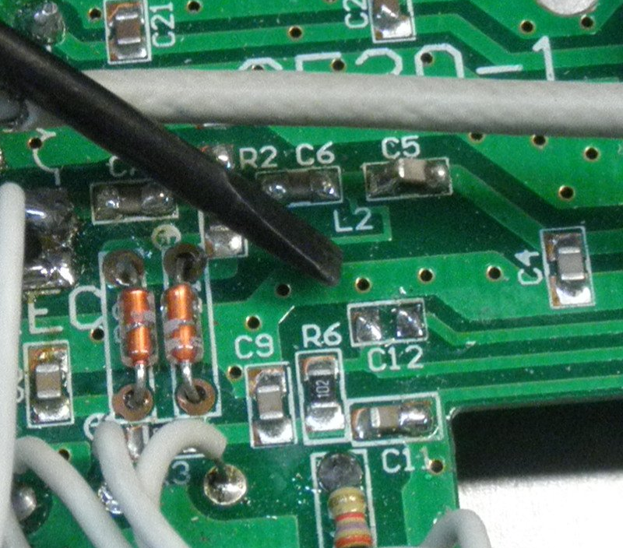
Close Up View
remove C12

Slide 11
repackage (optional)
The red and black wires that go to the squawker… is your output.
Output goes to sound card, or oscilloscope.

Slide 12
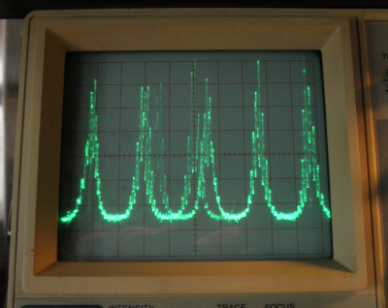
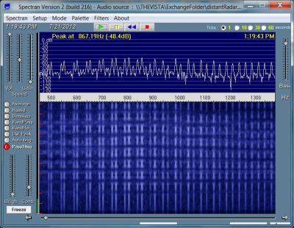
How to Display the Output
Listen to the output on anything that accepts line level, or watch it on an oscilloscope.
Input to your computer's sound card to: Spectran a free spectrum analyzer
http://www.weaksignals.com/

Slide 13
How to Display the Output
Listen to the output on anything that accepts line level, or watch it on an oscilloscope.
Spectran allows you to pass the signal through to your computer’s speakers.
Input to your computer's sound card to: Spectran a free spectrum analyzer
http://www.weaksignals.com/

Slide 14
Output Examples
(To play these wave files, they must be in the same folder with this .pptx file.)
← distant means weak. Use the volume control hear it louder.

Slide 15
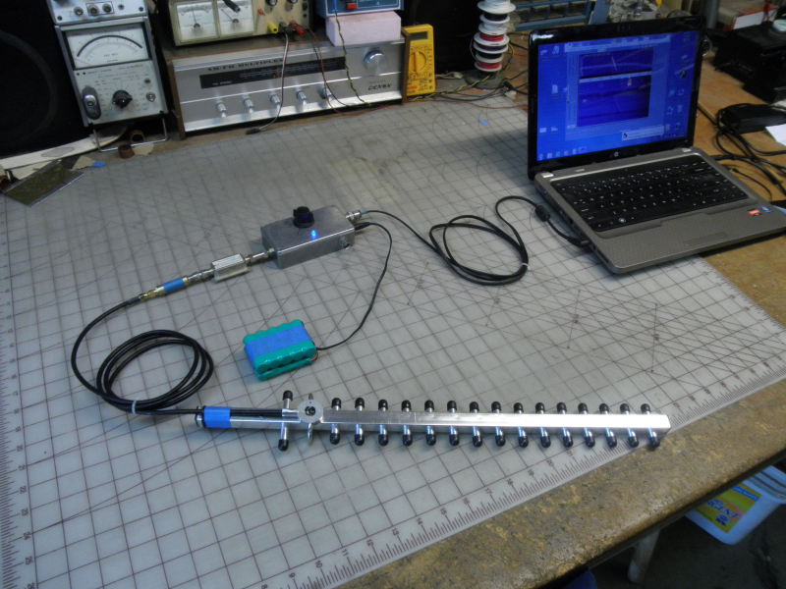
Repackaged SatFinder

Slide 16
Note the amplifier in place of the C-band LNB
Repackaged SatFinder
Amplifier and SatFinder go up to the WiFi frequency.

Slide 17
Note the amplifier in place of the C-band LNB
950 to 2,400 MHz
Amplifier and SatFinder go up to the WiFi frequency.

Slide 18
The wi-fi antenna needs an amplifier, the LNB does not.

Slide 19
This setup will allow you to see the spectrum of the modulation of your neighbor’s WiFi.

Slide 20
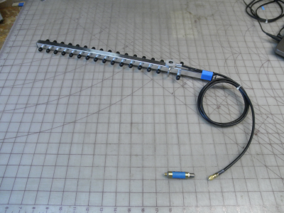
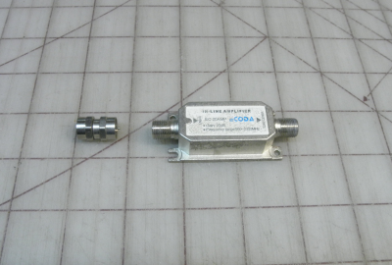
$5
http://www.ebay.com then
keyword: inline satellite amplifier
$17
http://www.ebay.com then
keyword: 2.4GHz 25 DBi Yagi WiFi Antenna

Slide 21
inline .01µ
capacitor
$5
http://www.ebay.com then
keyword: inline satellite amplifier
$17
http://www.ebay.com then
keyword: 2.4GHz 25 DBi Yagi WiFi Antenna

Slide 22
Make it your self with F-connectors or by it on eBay. Use keywords: DC power block
$5
inline .01µ
capacitor

Slide 23
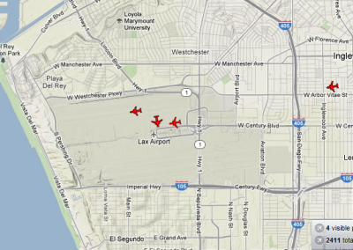
Just for Fun
The direction your dish is pointing will tell you which airplane you are listening too.
http://planefinder.net/
http://www.flightradar24.com/
http://flightaware.com/live/
Use these online flight radar maps to associate a particular spectrum (sound) from your monitor to the specific kind of airplane and airline. There’s at least a dozen different signatures. (...a dozen different manufacturer’s models.)
Wikipedia on Radar Altimeters
http://en.wikipedia.org/wiki/Radar_altimeter

Slide 24
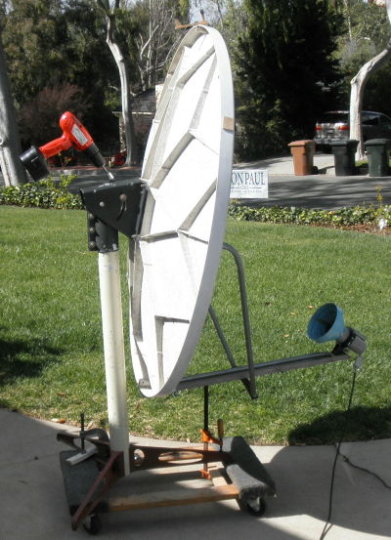
Just for Fun
Motorize elevation with a drill motor on standard dish mount.
Azimuth is easy and usually all you need to follow an airplane.
If you don’t have a dish, your range is limited to 2 to 4 miles. (But it’s easier to carry around.)

Slide 25
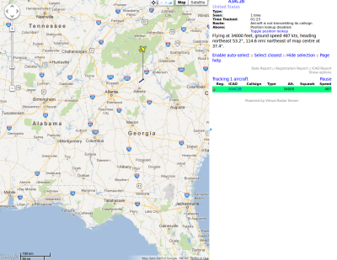
Next Project?
How about, monitor the 1092 MHz chatter between airliner and ground
http://www.hamradioscience.com/the-rtl-2832u-sdr-and-ads-b/

Slide 26
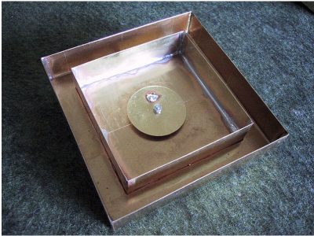
Or…
How about building your own radar altimeter?
http://lea.hamradio.si/~s53mv/radalt/radalt.html

