Slide 1
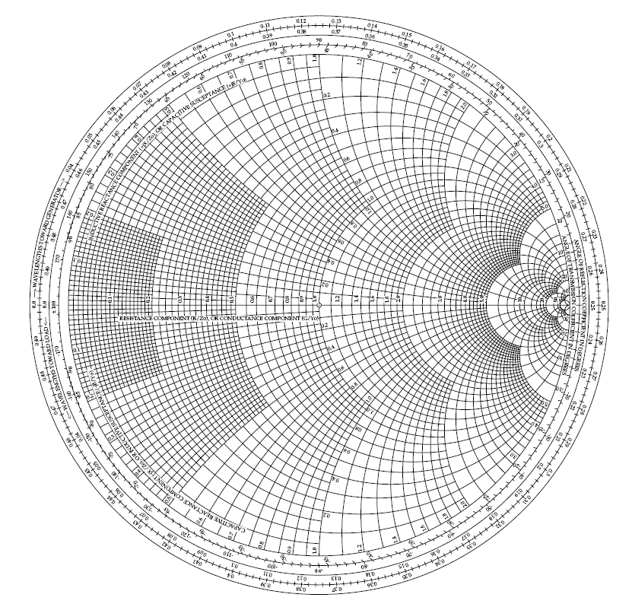
The Smith Chart
Dave Glawson – WA6CGR
SBMS – October 6, 2011

Slide 2
What is it?
Problem Solving Aid for RF
A Graphical Demonstrator of How Many RF Parameters Behave at One or More Frequencies
Problems Solved Manually One Frequency at a Time

Slide 3
Terms
Impedance (Z₀) (R+jX, R-jX)
Admittance (Reciprocal of Impedance) (Y₀, =Z⁻¹=1/Z)
Reactance +jX, -jX
Susceptance G+jB, G-jB (Reciprocal of Reactance)
Resistance in Ohms
Conductance in Siemens (Mhos) (Reciprocal of Resistance)
Characteristic Impedance of Z₀ = Characteristic Admittance of Y₀

Slide 4
Terms
Characteristic Impedance (Z₀) is Normalized
Z₀ = 50Ω Has No Special Significance
For minimum loss Z₀ = 77Ω
For maximum breakdown voltage Z₀ = 30Ω
For minimum temperature rise Z₀ = 60Ω
Γ (Gamma) = (Z_{L}-Z₀) / (Z_{L}+Z₀)

Slide 5
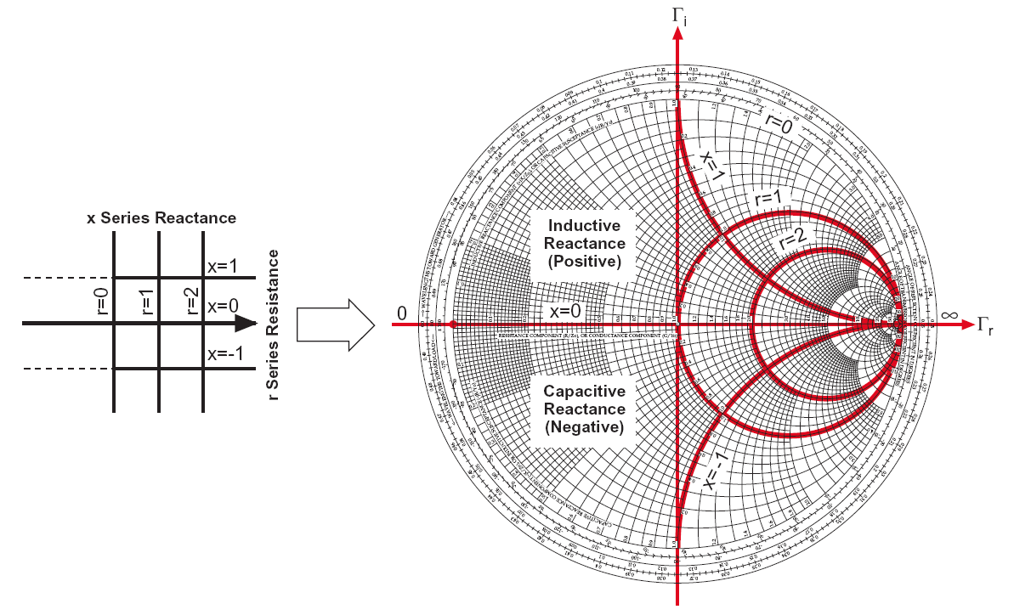
Impedance Coordinates

Slide 6
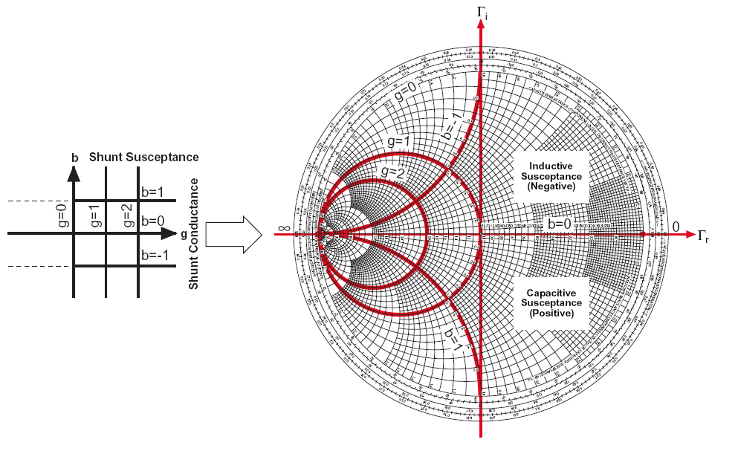
Admittance Coordinates

Slide 7
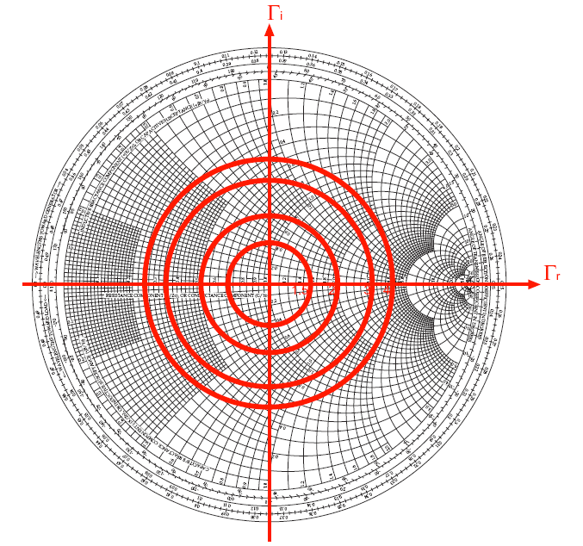
Constant SWR Circles

Slide 8
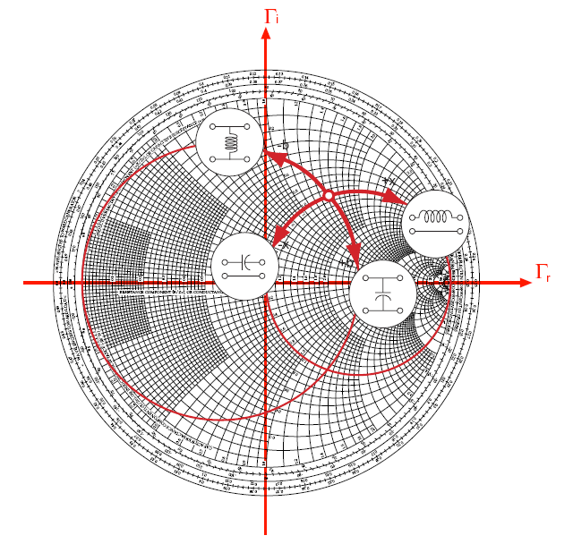
Effect of Adding Series Reactances or Shunt Susceptances

Slide 9
Determine the “Q” of Your Amplifier
Select the “Mean” Frequency of Your Band
Divide the “Mean” Frequency by the expected 3dB Bandwidth
Q=Fo/3dB BW
Example Center of Frequency Range = 450 MHz
3 dB Bandwidth of 100 MHz
Q = 450/100 = 4.5

Slide 10
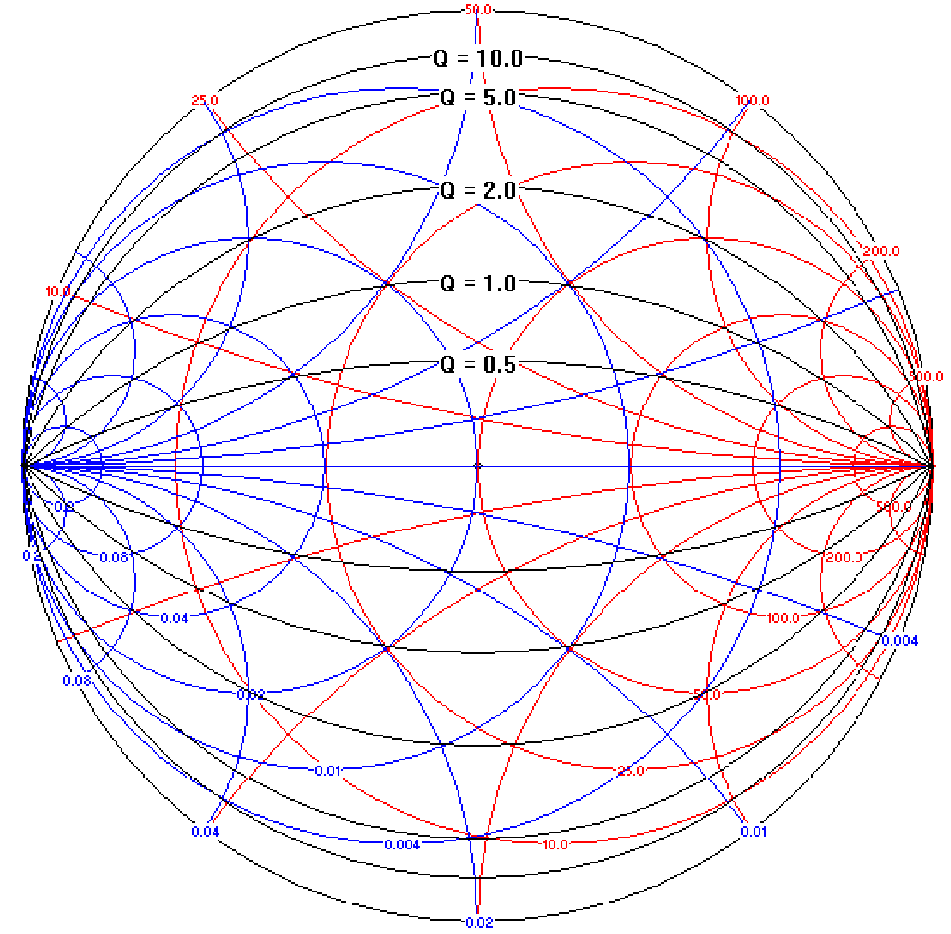
Smith Chart “Q” Circles

Slide 11
References
http://www.ham-radio.com/sbms/smithchart
WinSMITH
Example – MRF327

