Slide 1
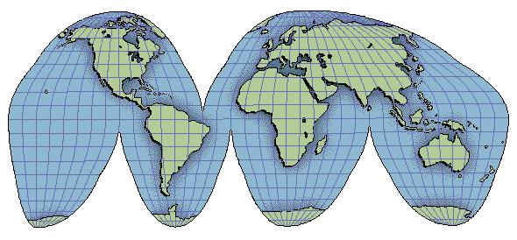
Amateur Radio in the 21st Century… mainstream or backwater?
Art Goddard W6XD

Slide 2
The Amateur Radio Service
Basis and Purpose
Creating Public Value
Is Amateur Radio Being Marginalized?
Accountability to the American People

Slide 3
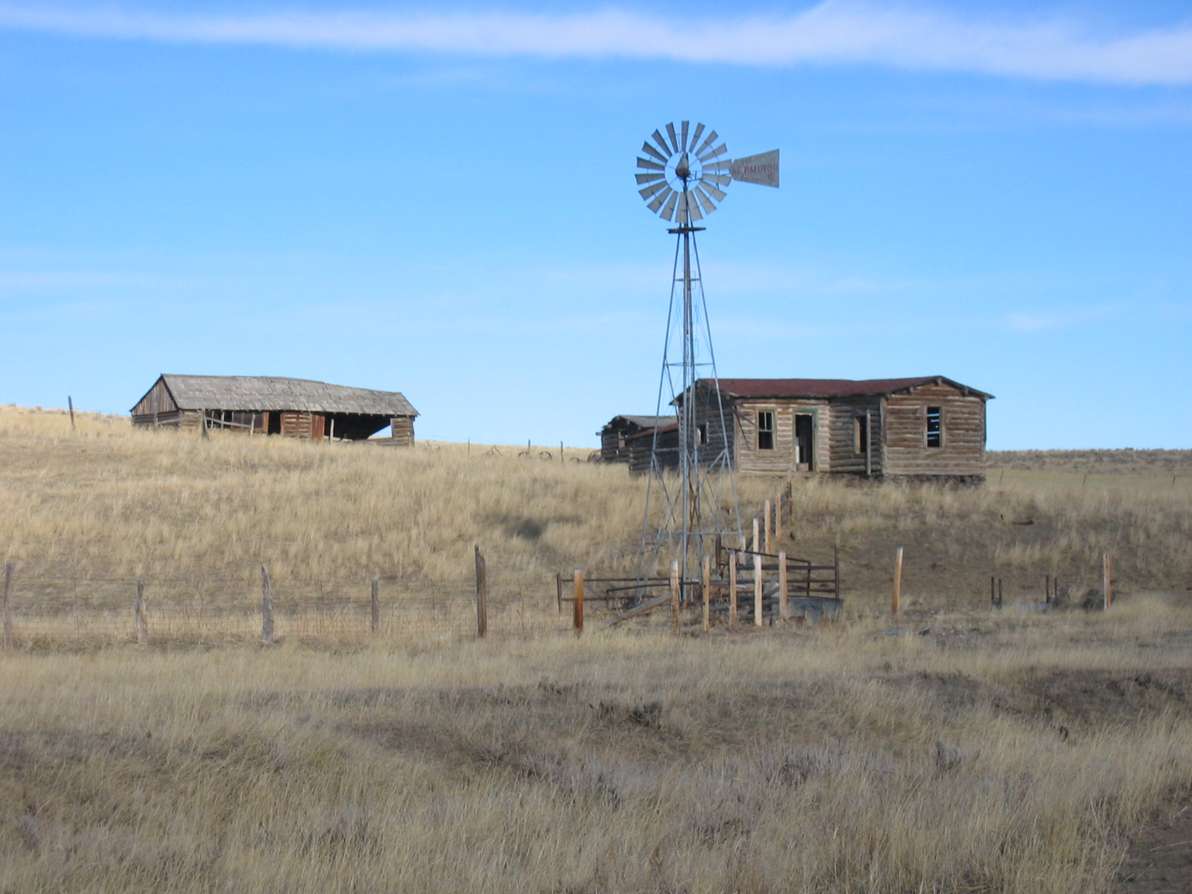
160 Acres

Slide 4
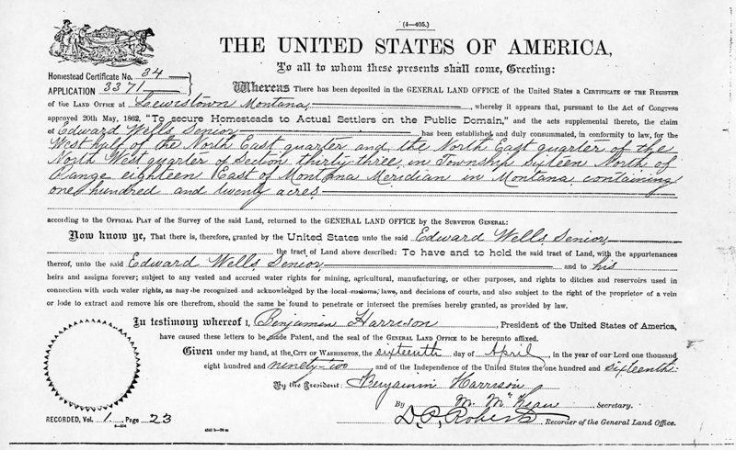
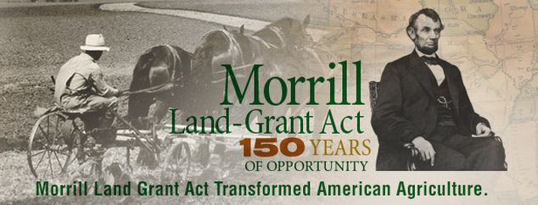
Land-Grant Act of 1862

Slide 5
Question:
How many of us have ever applied for and received a US Federal Grant?

Slide 6
Question:
How many of us have ever applied for and received a US Federal Grant?
Answer:
Every FCC Amateur Radio Licensee

Slide 7
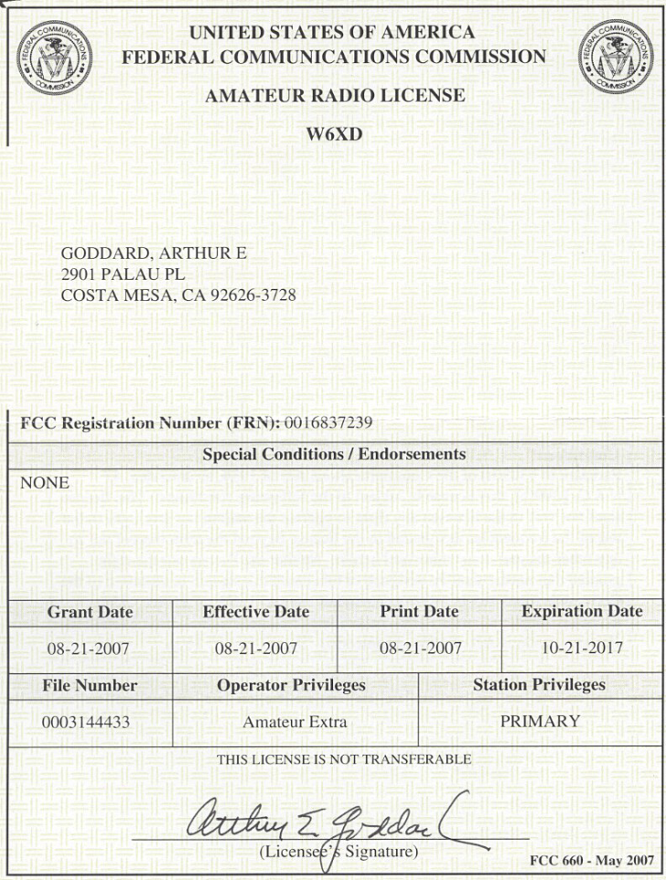
Federal Government Grants: No Free Lunch
A grant is used to transfer a thing of value to the recipient to carry out a public purpose
Source: Principles of Federal
Appropriations Law, 3rd Ed., V II

Slide 8
Your License Grant in 40 Words or Less
The Recipient:
You
The Thing of Value:
Access to the radio spectrum
The Public Purpose (§97.1):
(a) Enhance public value, particularly emergency communications
(b) Advance the radio art
(c) Advance skills in communications and technical areas
(d) Expand reservoir of trained radio operators, technicians and experts
(e) Enhance international goodwill

Slide 9
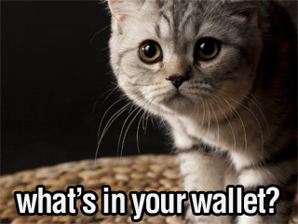
Fulfilling Our Public Purpose – Case 1

Slide 10
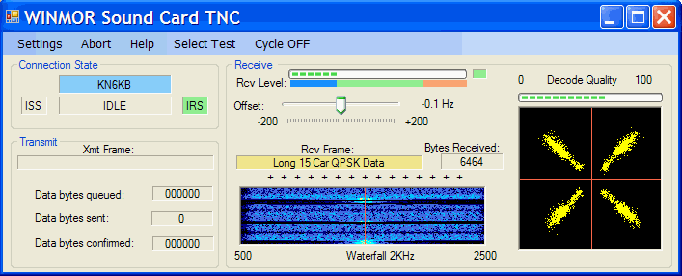
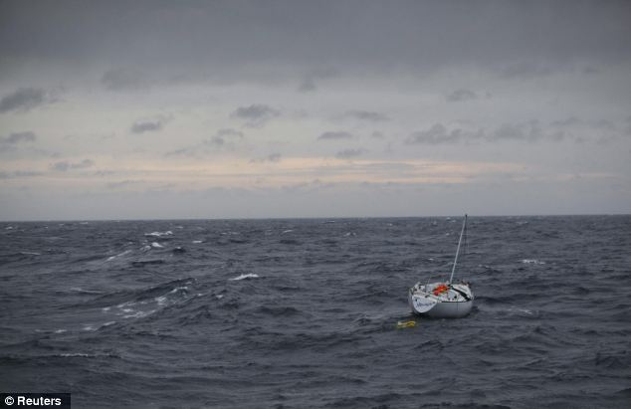
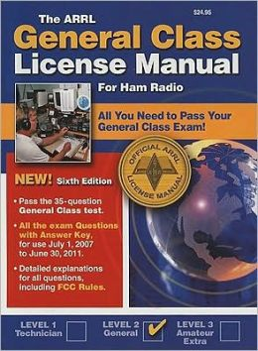
Fulfilling Our Public Purpose – Case 2

Slide 11
The Charles Atlas approach to fulfilling our public purpose has its limitations

Slide 12
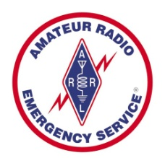
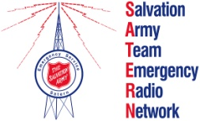
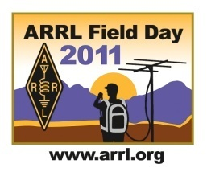
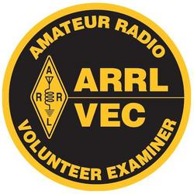
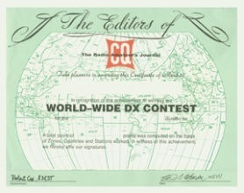
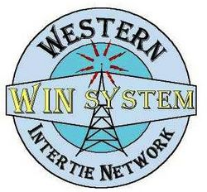
Fulfilling Our Public Purpose
Programs are essential to develop, focus and aggregate our individual efforts

Slide 13
OK, So How Well Is the Amateur Radio Service Doing in Fulfilling its Public Purpose?
?
?
?
?
?
§97.1(a)
§97.1(b)
§97.1(c)
§97.1(d)
§97.1(e)

Slide 14
OK, So How Well Is the Amateur Radio Service Doing in Fulfilling its Public Purpose?
?
?
?
?
?
§97.1(a)
§97.1(b)
§97.1(c)
§97.1(d)
§97.1(e)
If the Amateur Radio Service has no sense of accountability,
then maybe it’s better if nobody knows…

Slide 15
But then, Is Amateur Radio Being Marginalized?
Amateur Radio isn’t mentioned
in FCC’s Strategic Plan – It’s all about Wireless Broadband

Slide 16
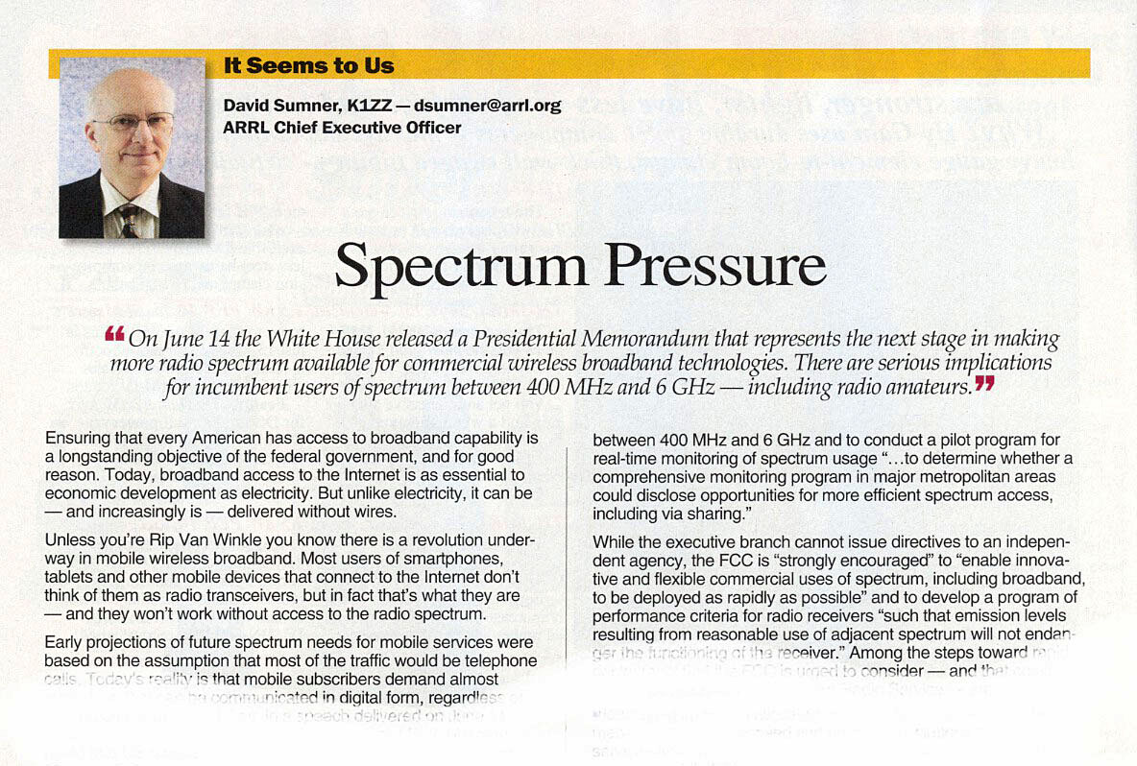
Is Amateur Radio Being Marginalized?
Source: QST, Aug 2013

Slide 17
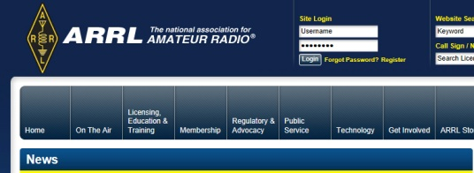
Is Amateur Radio Being Marginalized?
2013
Location service in 902-928 MHz band
Unlicensed broadband in 5.85-5.925 GHz band
FCC: Increased interference tolerance of broadband receivers
ARRL BPL petition denied by FCC
ARRL National Broadband Plan Committee Report
Recon Robotics in 430-448 MHz band
Increased interference potential from sweeping relaxation of Experimental Radio Service rules
2011-2012
FCC continued refusal to pre-empt CC&Rs
Unlicensed vehicular radar 77-81 GHz band
Pave Paws interference to 420-450 MHz band
HR 607 – Auction off 420-450 Band
Medical body-worn devices in 2360-2400 MHz band
Air Surveillance radar in 1240-1300 MHz band
Implanted medical devices in 413-457 MHz band
RM10165 terminated – Sought primary status 2300-2305 MHz
2008-2010
Mobile broadband 2305 – 2317.5 MHz band
FCC declines to exempt Ham operators from felony interference statutes in Florida and New Jersey
FCC allows Recon Robotics operation in 420-450 MHz band
ARRL asks court to compel FCC to comply with BPL ruling
Oceanographic Radar in the 3 – 50 MHz band
Source: ARRL Web News
Ham Radio Below the Radar – Bill Cross, FCC

Slide 18
Spectrum “Sharing” is like being Attacked by a Duck No One Bite is Fatal, But in The End You’re On Life Support
FCC
Amateur
Radio
HF-VHF-UHF
Microwave
Bands
WARC
Bands
LF/MF
Bands
5 MHz
“Band”

Slide 19
Still Not Convinced?
2002: BPL potential to trash the HF bands
Wi-Fi Era: Noise level increase in 2.4 GHz band
1980s: 433.92 MHz Periodic, Unlicensed Radiators
1988: 220-222 MHz to Land Mobile Service
1983: 2310-2390 MHz to Telemetry Service
1982: 1215-1240 MHz to Radiolocation Service
Source: ARRL and ATN

Slide 20
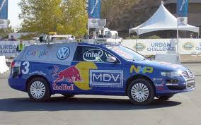
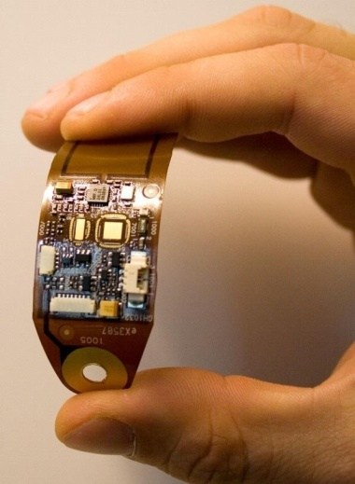
Preview of Coming Spectrum Challenges…
Broadband allocations for Self-Driving Autos
Broadband allocations for Domestic RPVs
BB and NB Allocations for Body-Worn Medical Devices

Slide 21
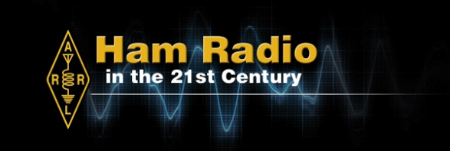
A Paradigm Shift is Long Overdue
ARRL’s spectrum defense is losing traction in part because Government decision makers are substantially unaware of our public value
ARRL is the self-proclaimed “Principal Representative of the Amateur Radio Service”
It is time for ARRL to step up to the plate and serve as a catalyst for accountability for the Amateur Radio Service
ARRL: It’s all that we have

Slide 22
ARRL in the 21st Century
Compile and report today’s baseline public value created by the Amateur Radio Service
Act strategically to enhance, extend, encourage, and expand public value per §97.1
Report periodic updates to FCC, Federal, State and Local Government and the American People

Slide 23
Amateur Radio’s Report to America
The Amateur Radio Service is one of the most successful Federal grant programs ever
Government costs to administer are minimal
Current licensees are engaged in volunteer testing of new applicants
Current licensees are engaged in monitoring for rules compliance
Also we should be able to say
The number of licensees is tracked at the county level to assure public value expectations are met

Slide 24
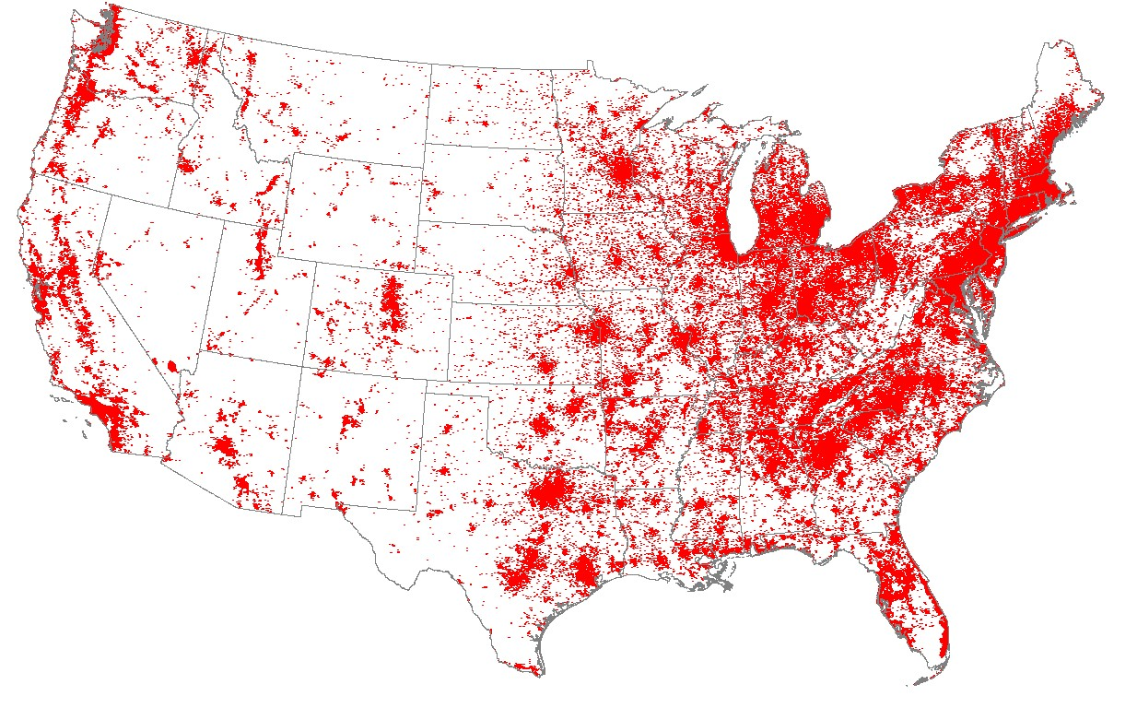
Amateur Radio’s Report to America
Who is working to address areas under-served by Amateur Radio?
Source:
HamCallTM

Slide 25
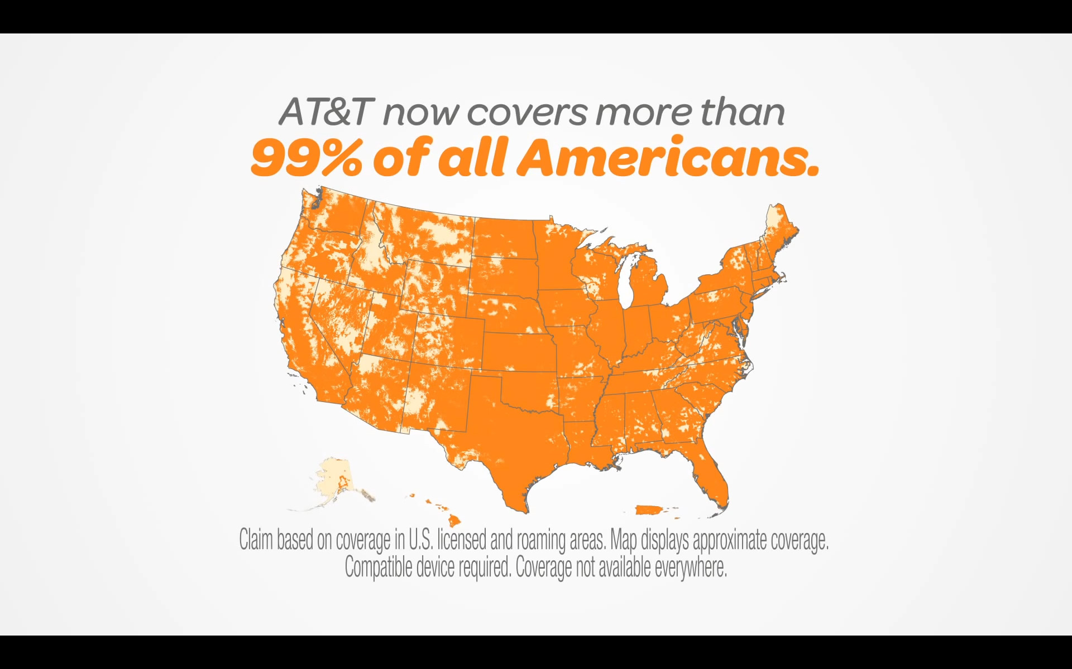
AT&T Gets It!

Slide 26
Amateur Radio’s Report to America
Through a network of trained and motivated volunteer radio communicators, the Amateur Radio Service saves lives and protects property across America
MOAs are in place with major relief agencies
Map of emergency/disaster services
Statistics of reduction in human suffering and property damage
Positioned to assist during brownout, wildfires, super-storms and other severe weather events tied to global warming

Slide 27
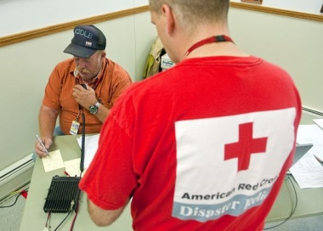
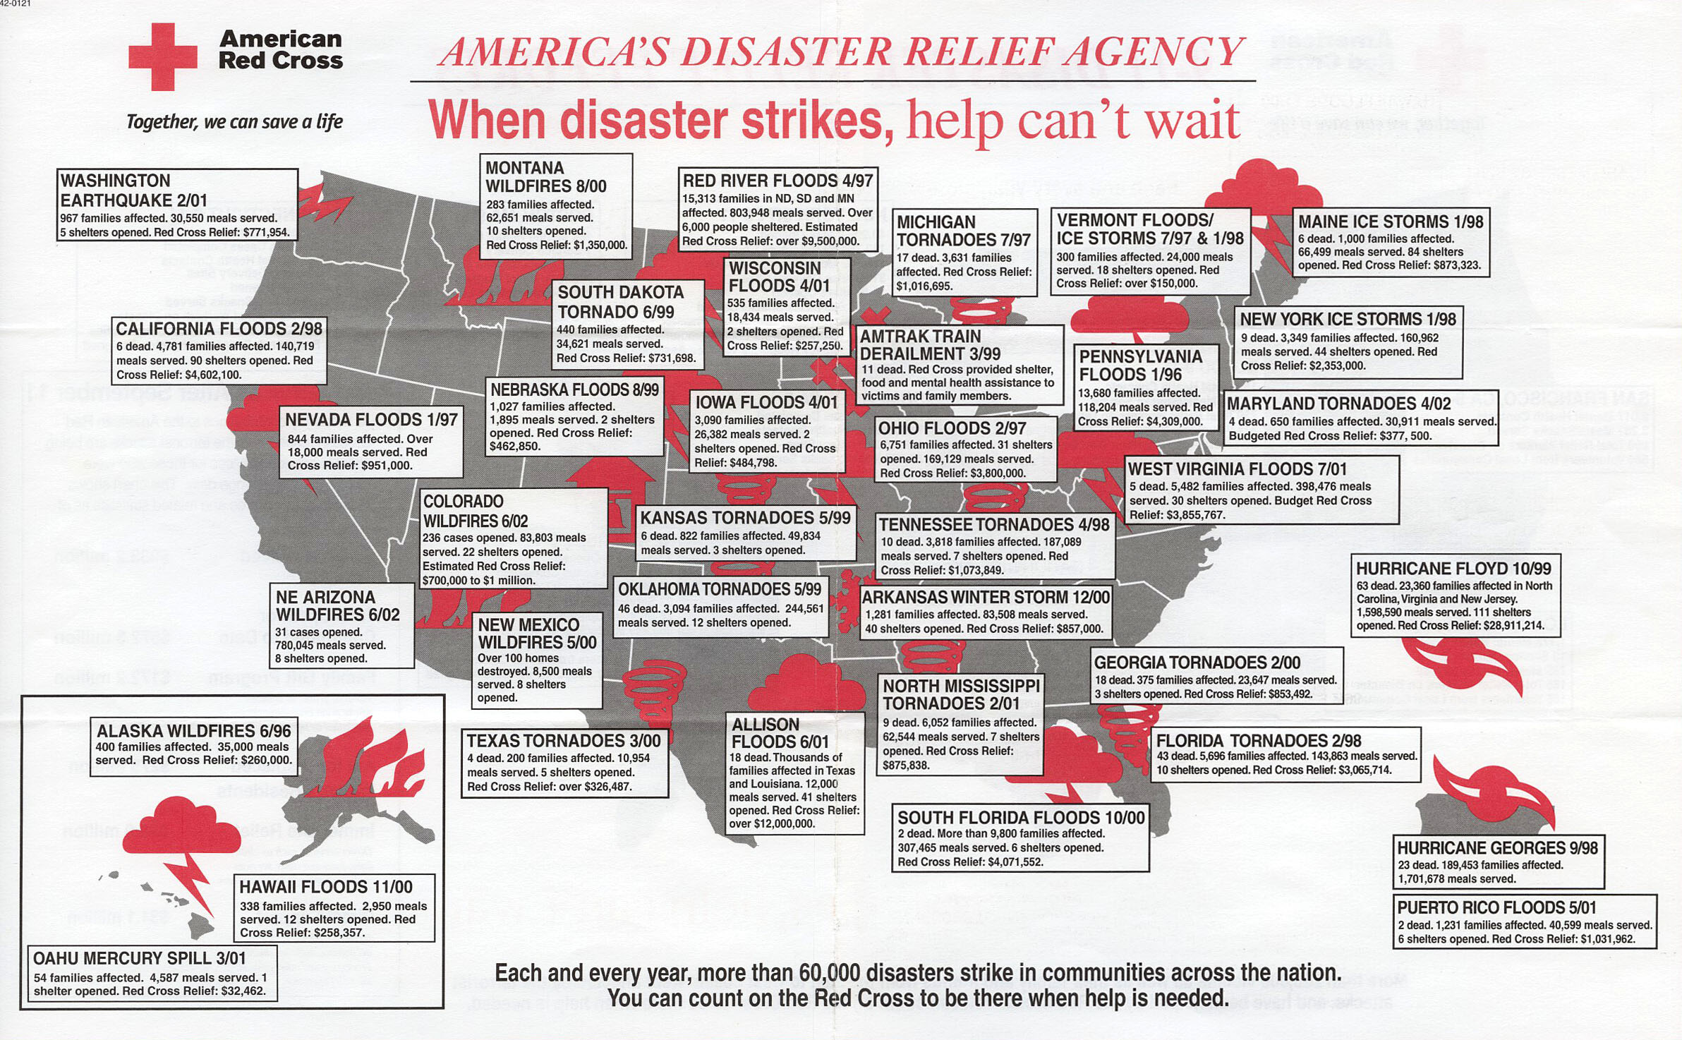
Amateur Radio’s Report to America

Slide 28
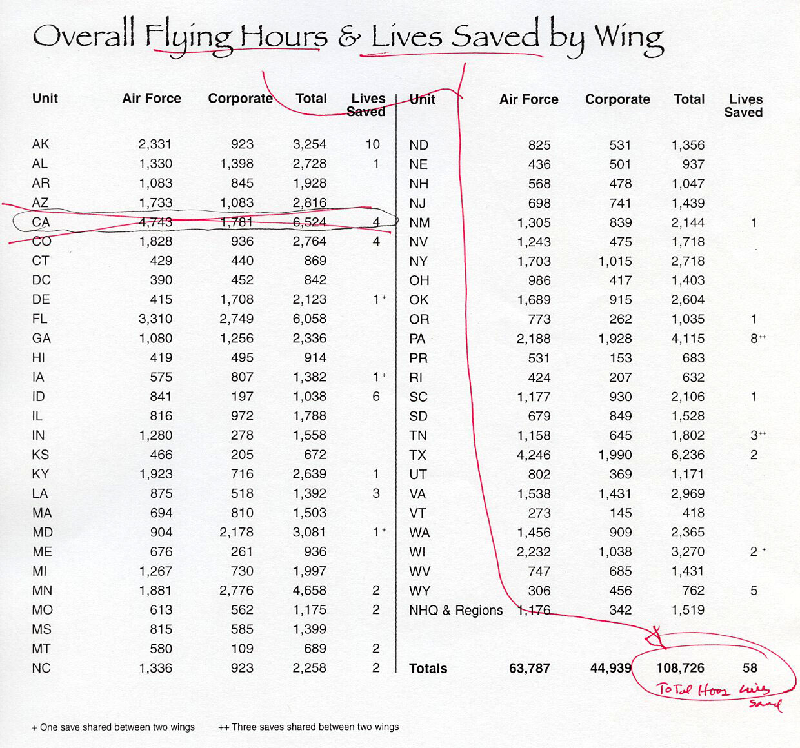
Amateur Radio’s Report to America
Source:
Civil Air Patrol 2006

Slide 29
Amateur Radio’s Report to America
The Amateur Radio Service fulfills its role through volunteer effort and privately-owned equipment linked in robust networks
Compilation of volunteer hours and labor cost avoidance to served agencies
Compilation of capital equipment investment by licensees and organizations
Amateur Radio networks are distributed nationwide, free from the constraints and vulnerabilities of commercial and Internet infrastructure and in many cases the power grid too.
Amateur Radio networks are not susceptible to Denial-of-Service hackers

Slide 30
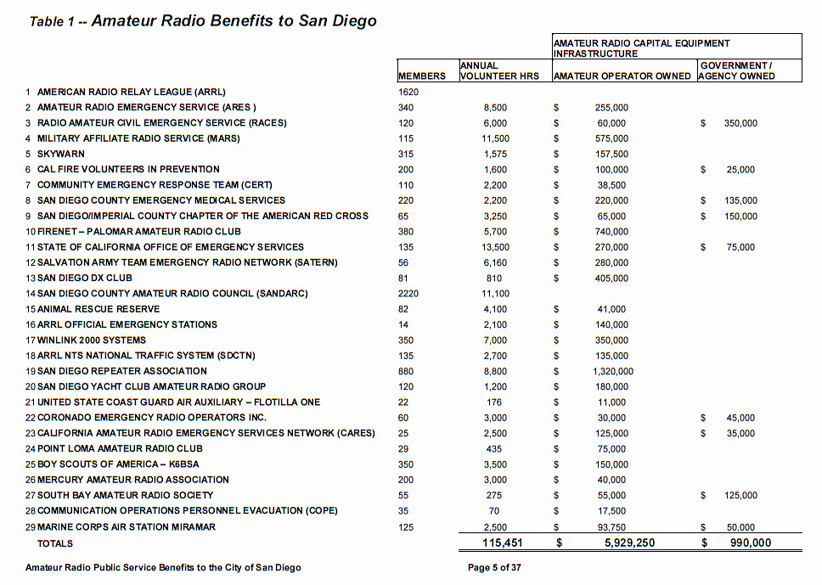
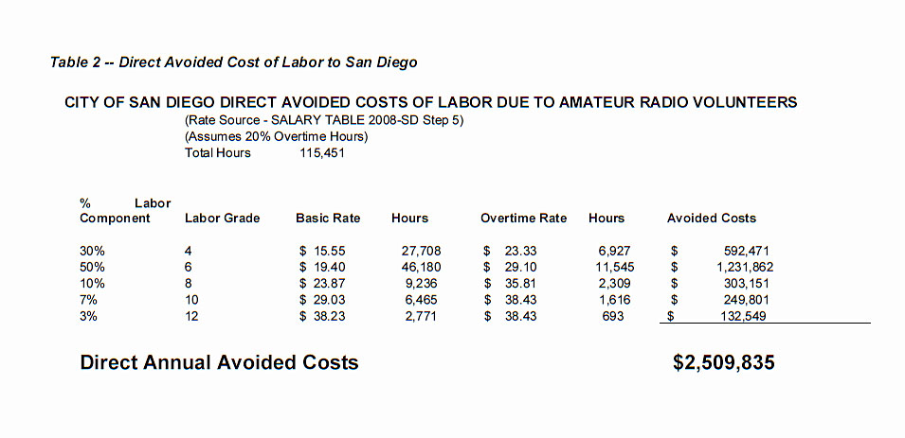
Amateur Radio’s Report to America
Example:
City of San Diego
Source: Amateur Radio Public Service Benefits to the City of San Diego, Jan 2009

Slide 31
Amateur Radio’s Report to America
The Amateur Radio Service develops leaders for government and the private sector
Listing of “People in High Places” with callsigns
Personal testimony of role of Amateur Radio in career

Slide 32
Amateur Radio’s Report to America
Gordon England ex-W3AWO
Deputy Secretary of Defense; Former Secretary of the Navy; Defense Exec
Owen Garriott W5LFL
NASA Astronaut – First Radio Amateur to make contacts from space
Edmund Giambastiani N4OC
Vice Chairman, Joint Chiefs of Staff, (Retired0
Gerald Griffin K6MD
Brigadier General, Medical Corps, US Army, (Retired)
J. Scott Redd K0DQ
Director, National Counterterrorism Center, Commander, US 5th Fleet (Retired)
Joe Taylor K1JT
Nobel Prize recipient – Physics
Tony Tether K2TGE
Director, DARPA
Walter Cronkite KB2GSD
News anchor – “The most trusted man in America”
EXAMPLE

Slide 33
Amateur Radio’s Report to America
Radio Amateurs develop valuable technology that benefits our nation’s economy
Synopsis of Dayton, CQ and ARRL Technical Awards
Other developments from our long history

Slide 34
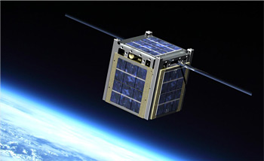
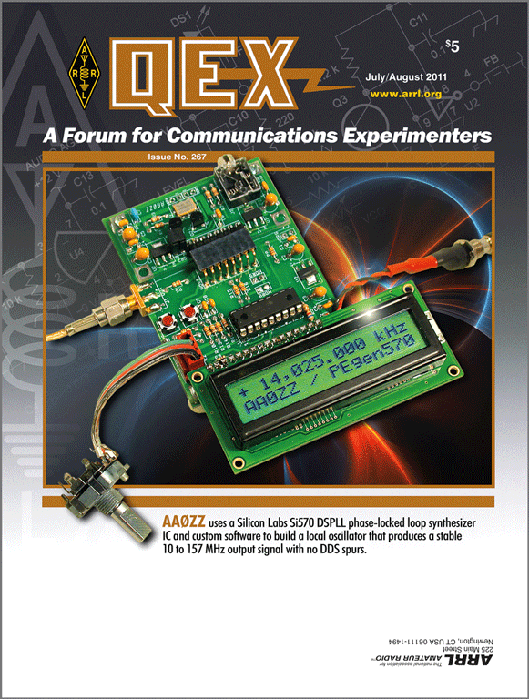
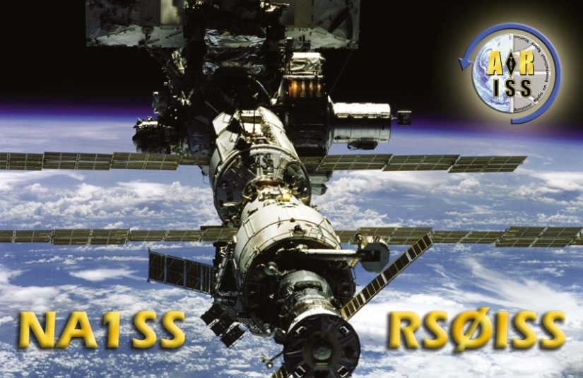
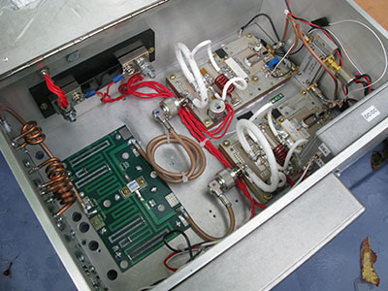
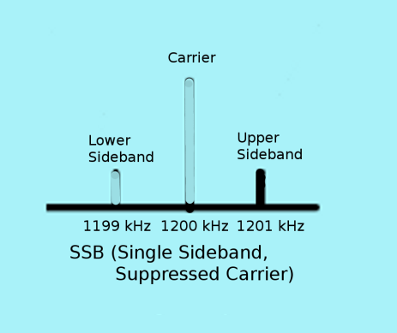
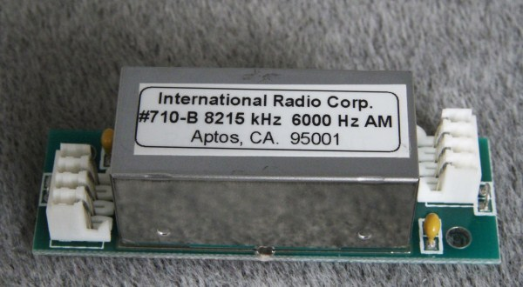
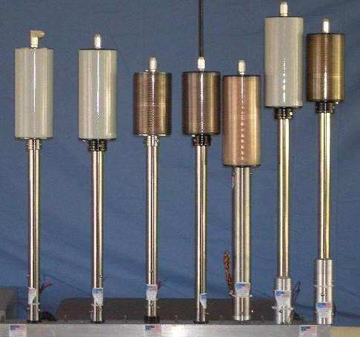
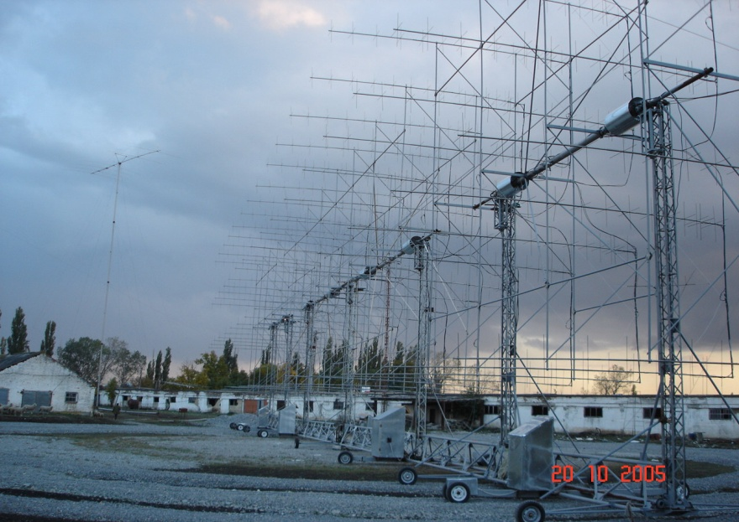
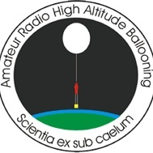
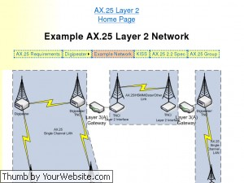
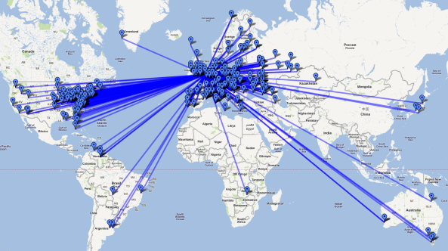
Amateur Radio’s Report to America

Slide 35
Amateur Radio’s Report to America
Radio Amateurs extension of international goodwill is unmatched at the person-to-person level
Every Radio Amateur in the world shares common interests and experiences that transcend cultural differences
Compile the number of international QSOs from LOTW, QSL Bureaus, DXpedition and DX contest logs
List the UN countries having Amateur Radio activity during the reporting period
Highlight radio sport including WRTC and ARDF

Slide 36
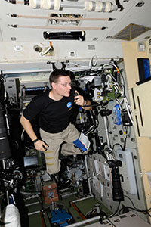
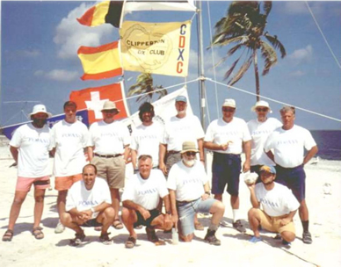
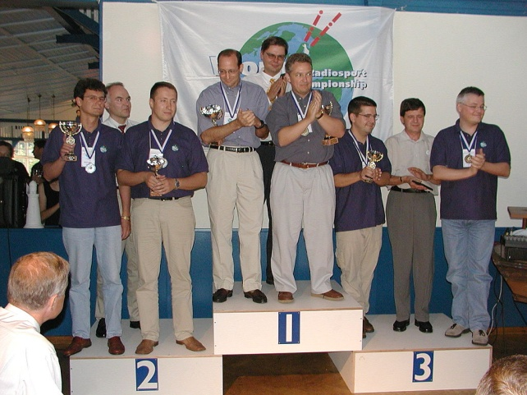
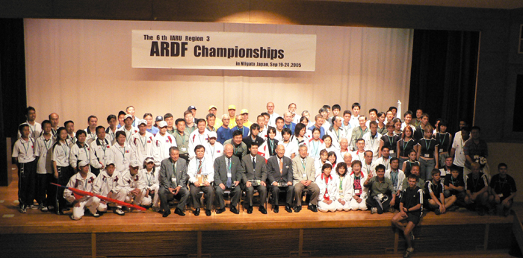
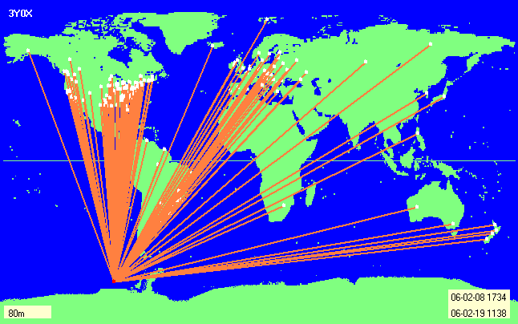
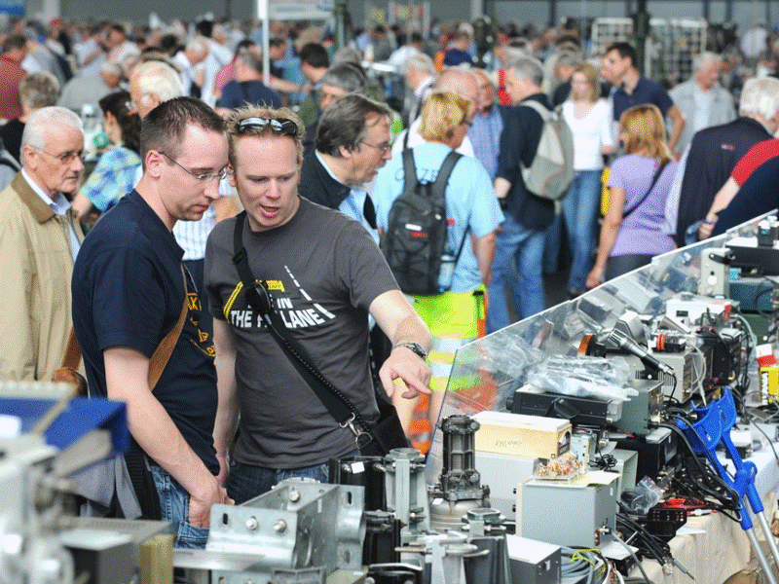
Amateur Radio’s Report to America
Radio Amateurs extension of international goodwill is unmatched at the person-to-person level
Logbook of The World
Reaches 500 Million QSOs

Slide 37
Amateur Radio’s Report to America
Personal achievement and recreation are integral components of the Amateur Radio Service
Provides the impetus for developing skills, purchasing equipment, building networks and maintaining readiness to meet public service objectives
Amateur Radio is similar to the Civil Air Patrol and Coast Guard Auxiliary, where skilled personnel and privately-owned resources are available to support government and other agencies in time of need

Slide 38
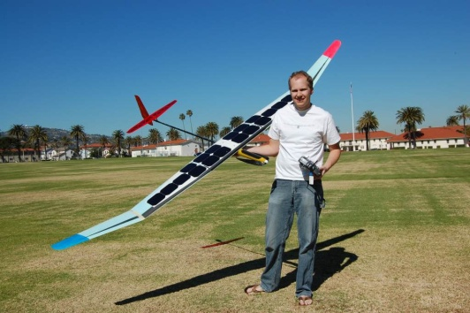
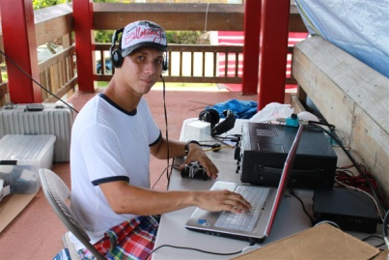
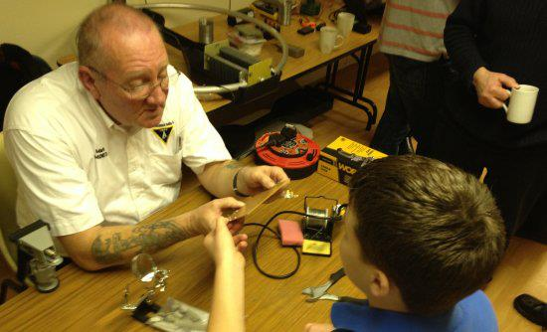
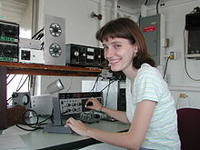
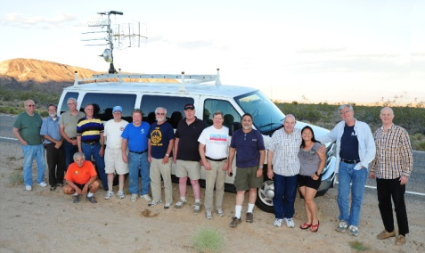
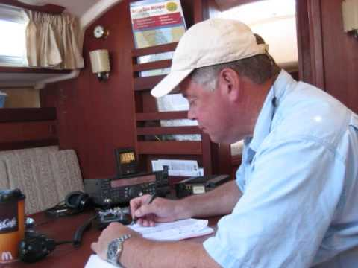
Amateur Radio’s Report to America
Personal achievement and recreation are integral components of the Amateur Radio Service

Slide 39
Amateur Radio’s Report to America
The Amateur Radio Service has two basic needs in order to fulfill and extend its Public purpose per §97.1
Access to frequency bands
- Spaced across the radio spectrum relatively free from interference
A regulatory environment that permits the installation of reasonable antennas
And there are obstructions to be overcome
Maintain watch list of impacted Amateur Radio frequency bands
Compile statistics on the pervasiveness of CC&Rs and the impact to the Amateur Radio Service
Maintain watch list of communities that either obstruct or choose to be underserved by the Amateur Radio Service as a result of local regulations

Slide 40
Amateur Radio’s Report to America
The Amateur Radio Service has two basic needs in order to fulfill and extend its Public purpose per §97.1
Access to frequency bands
- Spaced across the radio spectrum relatively free from interference
A regulatory environment that permits the installation of reasonable antennas
And there are obstructions to be overcome
Maintain watch list of impacted Amateur Radio frequency bands
Compile statistics on the pervasiveness of CC&Rs and the impact to the Amateur Radio Service
Maintain watch list of communities that either obstruct or choose to be underserved by the Amateur Radio Service as a result of local regulations

Slide 41
Amateur Radio’s Report to America
The Report must be produced in as many different formats and media as practicable
The Report must be the object of proactive, widespread dissemination

Slide 42
Amateur Radio’s Report to America
STATUS UPDATE – Motion Adopted Jan 2014
ARRL Board of Directors directs staff and the PR Committee to:
Prepare a draft of an annual or biennial “Report to America”
Quantifying radio amateurs’ contributions to the public
Said draft to be prepared for consideration by the next Board meeting
Such document should be appropriate for presentation to legislators and other governmental officials.
A journey of 1000 miles begins
with a single step
-Lao-tzu

Slide 43
Amateur Radio’s Report to America
Individual Licensees
Maintain basic preparedness
Assess public value added
Help paper hams get on the air
Contact ARRL:
Division Director XXX@arrl.org
Dave Sumner k1zz@arrl.org
Kay Craigie n3kn@arrl.org
Radio Clubs
Form a position and contact ARRL
ARRL Donors
Make your wishes known

Slide 44
The noblest motive is the public good
Motto - San Diego County Seal

Slide 45
This Program on YouTube:
http://youtu.be/xmT1BXyZsy8
Powerpoint Charts
www.w6xd.com/Future/AmateurRadio

Slide 46
Discussion Item: Progress Reporting
Membership
Total Membership, Area Covered, Occupations Profile
Operating Achievements & Activities
Spectrum Usage
New Records and Awards
Technical Advancements & Applications
Experiments, Techniques & Technologies
Patents & Technical Awards
Supporting Lab Capabilities
Publishing Activities
Web Pages, BLOGs, Papers, Articles, Books
Conventions & Exhibits
Public Outreach
Maker Faire, etc
Obstructions to Mission
CC&Rs, RFI from Part 15 Devices, etc

