Slide 1
WSJT-X FT8 Mode
Main Display and Waterfall

Slide 2
What is this “WSJT-X” all about and why talk about it as a Microwave Radio Amateur
Modes of Interest for Microwave 10 GHz
WSPR – FT8 – JT4-x

Slide 3
History.
Marconi
Amateur developments , CW, AM,,
- jt65. SSB,
High speed CW, HSMS, FSK, coding schemes

Slide 4
Marconi Transmitter: Spark Source ( Info Generator ) Receiver: Mechanical Tape writer ( Info Receiver )

Slide 5
Amateur developments:
Amateur developments:
- CW
- AM
- SSB
- High speed CW
- HSMS
- FSK
- Coding schemes

Slide 6
Since then, many improvements and newer dedicated modes. W3IMI, now K3IO, Tom Clark, NASA Astronomer, AMSAT N4HY, Bob McGuir, NSA, Flex Radio. KA9Q, Phil Karn, AMSAT K1JT, Joe Taylor, Nobel Price Winner, Astronomer

Slide 7
JT65 By 1970 EME had become popular at 144, 432 and 1296 MHz. Many and Big requirements: Antennas Power Copying CW in Noise Space around the house Good Neighbors

Slide 8
Efforts to make life easier. By that time professionals with radio as a hobby started to apply scientific knowledge. In AMSAT, etc and also in EME. In Moonbounce, EME concepts. In SDR technology.

Slide 9
Tools: New Tools for Weak signal detection. Availability of computers big contribution. Concepts in Science such as Fourier Analyses and FFT JT65 one of the results. Data processing possible with simple computers. JT65 as EME protocol another of the results. Astronomical Tracking Antenna Pointing

Slide 10
Why using DSP? One procedure in DSP is the so called FFT, Fast Fourier Transform. FFT’s will process analog signals ( amplitude vs. time ) and translates them in amplitude vs. frequency form. Many newer instrumentation these days, use FFT’s. Spectrum Analyzers, VNA’s, etc . Displaying and measuring the amplitude of a signal vs. its frequency, in its simplest form.

Slide 11
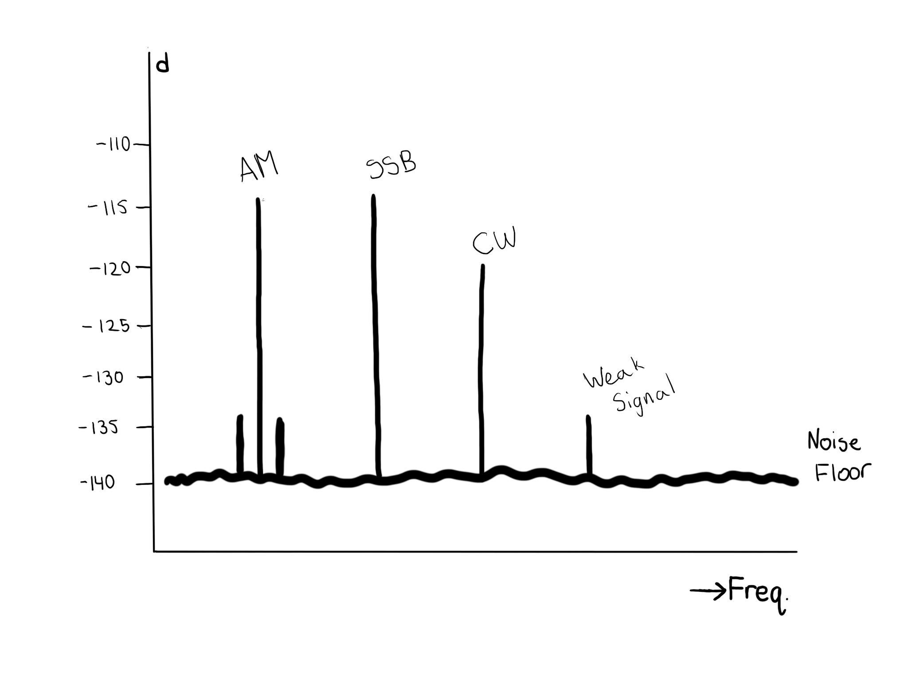
Signal vs. Frequency

Slide 12
Detection of very weak signal
In JT8 waterfall
at 1900 Hz

Slide 13
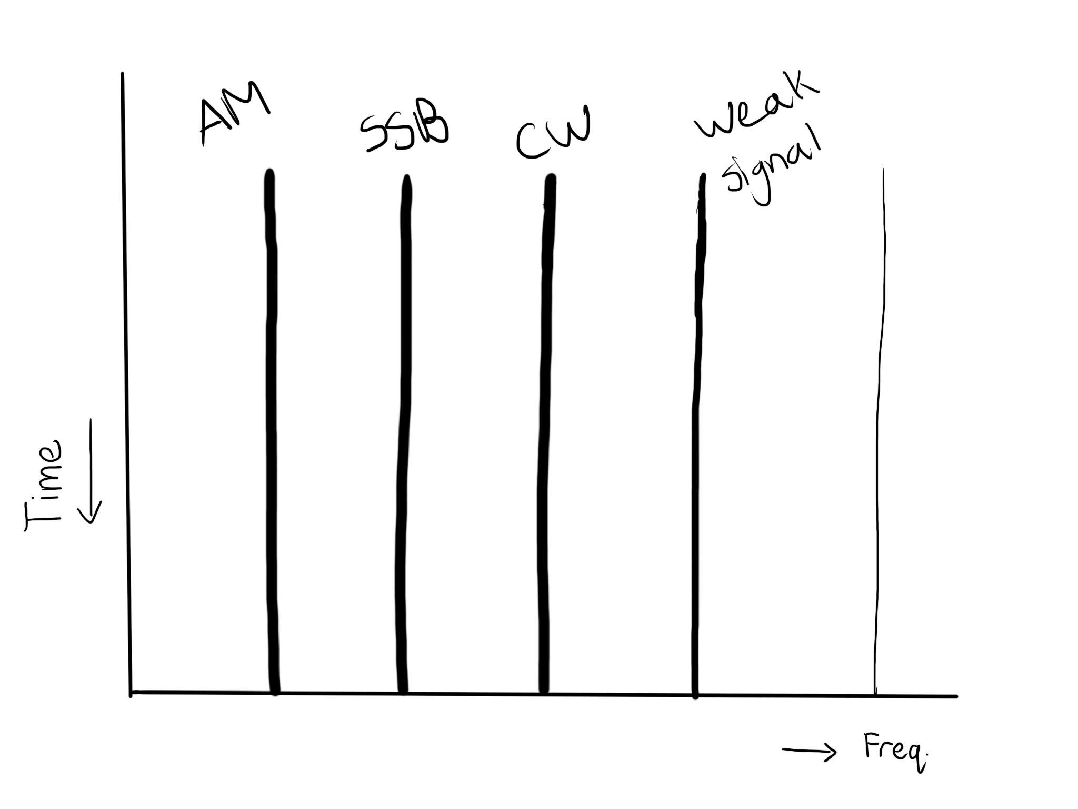
Signal vs. Frequency (cont.)

Slide 14
How do I use this? Connection from radio audio to computer. Generated computer Audio drives Transmitter. Audio from Receiver drives computer processing. Computer generated T/R signal provides radio T/R switching. Computer programs to make this possible.

Slide 15
and Programs for WSJT-X. Windows XP and higher. Computer and Computer Programs Windows XP and later. Linux. Mac. Raspberry PI in some modes. WSJT is probably the best documented Program in Amateur Radio. There are user Manuals. Manuals about the Theory. Numerous user lists. K1JT is the author with help from others. https://physics.princeton.edu/pulsar/k1jt/ Google “WSJT(-X)” provides info in aspects.

Slide 16
WSJT-X modes for 10 GHz WSPR FT8 JT4

Slide 17
Radio Computer Interfacing. Computer and Radio Interfacing Most Transceivers provide dedicated connectors with for TX and RX audio plus T/R switching. Older Computer carry, in many cases, audio in (MIC) and out connections. Also RS232 ( com ports ) are often available. Newer computers and in particular laptops might not have separate audio. WSJT has possibilities to use external sound cards.

Slide 18
Computer Interface home brew

Slide 19
Computer Interface with 1:1 transformers

Slide 20
Commercial Interfacing Unit

Slide 21
WSJT time Syncing
All WSJT(-x ) Need Time Synchronization
for Receiving and Transmitting.
Via Internet.
GPS.

Slide 22
Time in the field.

Slide 23
WSJT-X modes for 10 GHz use.
WSPR
FT8
JT4(x)

Slide 24
WSPR

Slide 25
N3IZN at 432 MHz WSPR

Slide 26
N3IZN-W6SZ , 10 GHz WSPR

Slide 27
Here all WW WSPR Activity 11:45 PST 12/02/18

Slide 28
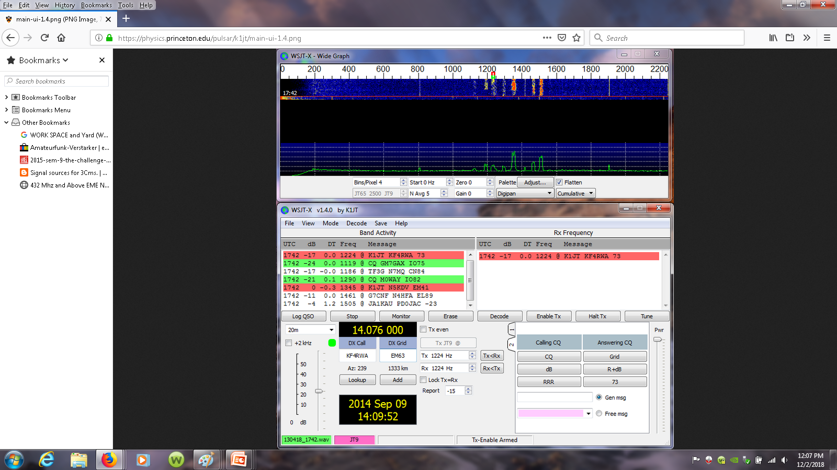
FT8

Slide 29
FT8 details
Messages RX: 15 sec
Messages TX: 15 sec
Basic Format:
WA6JBD - N6RMJ DM14
WA6JBD - N6RMJ -4
WA6JBD - N6RMJ R -4
WA6JBD – N6RMJ RRR
WA6JBD – N6RMJ 73
CQ N6RMJ
Total Time 6 * 15 secs.
Newer version uses 6 Digit Grid

Slide 30
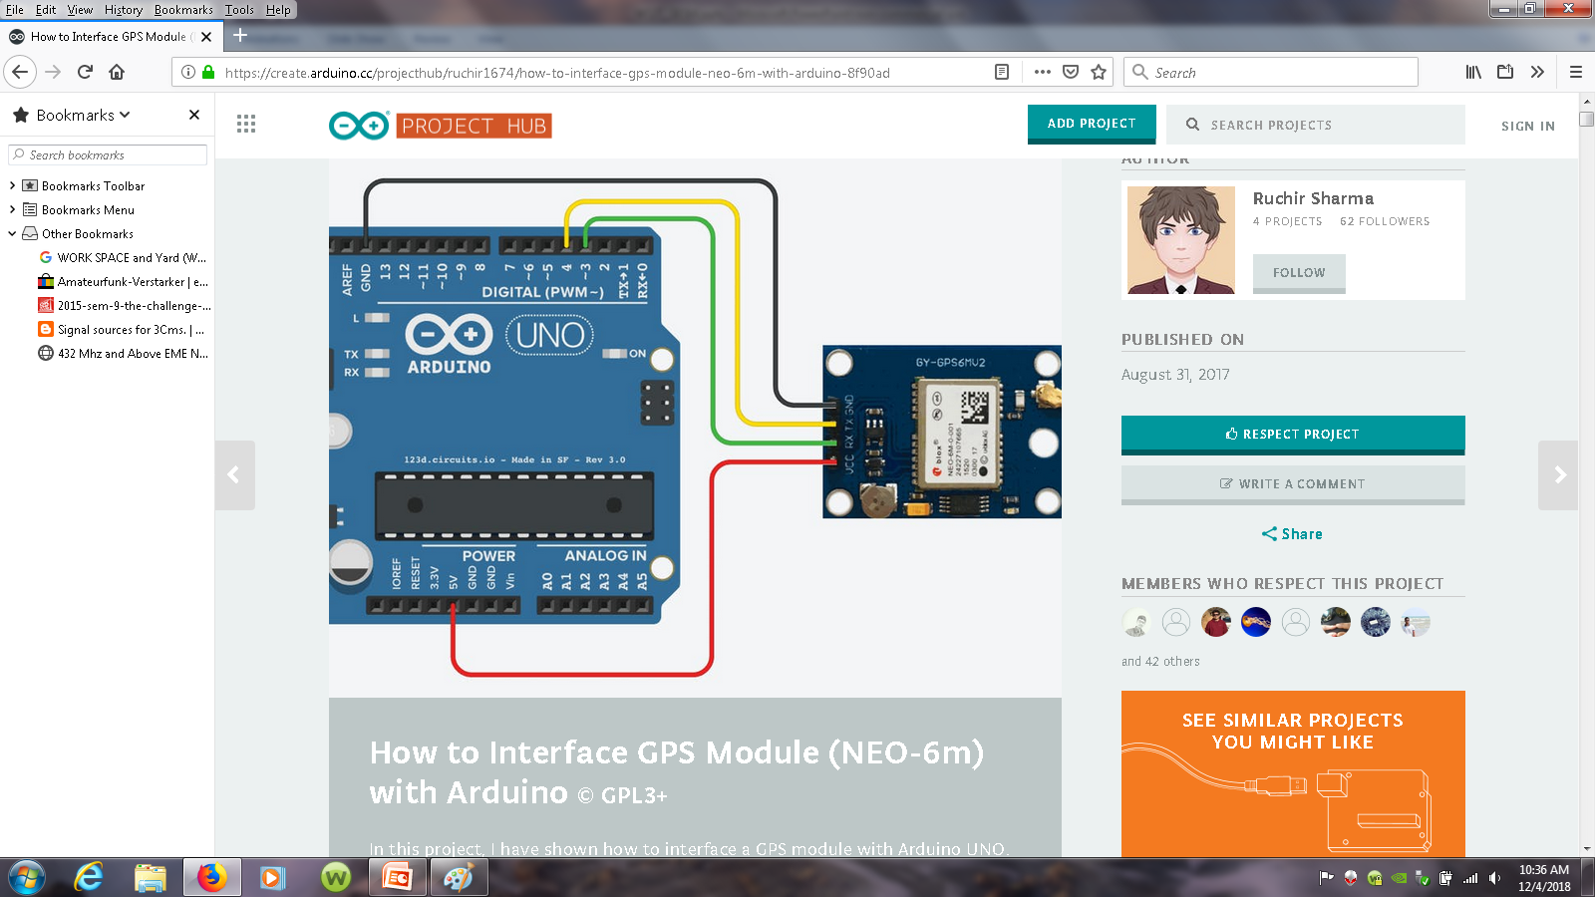
FT8 vs other com. modes

Slide 31
FT8 on PSK reporter

Slide 32
Message Content in WSJT-X
Exchange of Calls and a piece of unique info
Earlier Versions of WSJT fixed Format
--Latest addition 6 digit Grid info--
CQ N6RMJ DM14FN42
N6RMJ WA6JBD DM14
WA6JBD N6RMJ +2
N6RMJ WA6JBD R-22
WA6JBD N6RMJ RRR
N6RMJ WA6JBD 73

Slide 33
JT4 Waterfall

Slide 34
JT4 main

Slide 35
Message Structure: -- 6 digit Grid Info -- CQ TEST N6RMJ DM14 N6RMJ WA6JBD DM14 WA6JBD 003 DM14xx ** N6RMJ 065 DM14ed ** WA6JDB N6RMJ RR 73

Slide 36
VK7MO beaming over water in order to
reach WA3LBI in Penssylvania ( EME record )

Slide 37
Conclusions:
Critical factors which made this World Record possible were that
both stations being able to work
portable and select locations with zero take-off.
The use of
the very sensitive QRA64D mode and
selecting a time when the common window was maximized and
spreading and lunar libration were
low.
Rex, VK7MO

