Slide 1
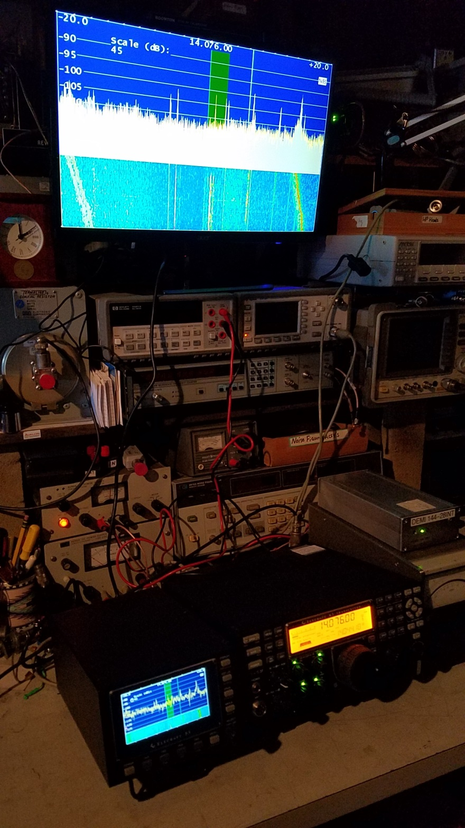
EME Station Back End
Db6nt converter
DEM 144/28mhz transverter
Elecraft K3 reads 1296.000
P3 Panadapter
24” Monitor

Slide 2
Microwave Power sensor Limitations
Doug Millar K6JEY
drzarkof56@yahoo.com

Slide 3
Scope of Talk
RF power Sensor ratings
Test equipment used and useful
Clinic to measure DB attenuation on
  Power Meters
  Attenuators
  Spectrum Analyzers

Slide 4
Background
Interest in metrology and the accuracy limits of RF power
Considerable experience with power meters
The arrival of a Boonton generator pushed me to explore the accuracy of sensors and their linearity.
I was only able to resolve four digits accurately with the calorimeter.
It turns out that is good enough.

Slide 5
Definitions
Bolometer/thermistor- Resistance changes with exposure to RF
Thermocouple- Voltage is generated by exposure to RF in two dissimilar metals.
Thermopile- a series of dissimilar metals that generate DC voltage when exposed to DC or AC voltage.
Diode Sensor- generates a DC voltage through diode rectification.

Slide 6
Traceability tools
At Boonton
NIST Micro Calorimeter for DC substitution
Wandel and Goltermann EPM 1 –
Accurate but little resolution
Trombone attenuator at 30MHz
Boonton 2520 .05db accuracy
At HP
0dbm thermistor reference sensor. (HP 478 h75)

Slide 7
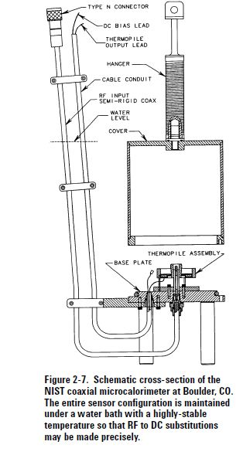
Micro calorimeter at NIST
Calibration is done at
30-50Mhz

Slide 8
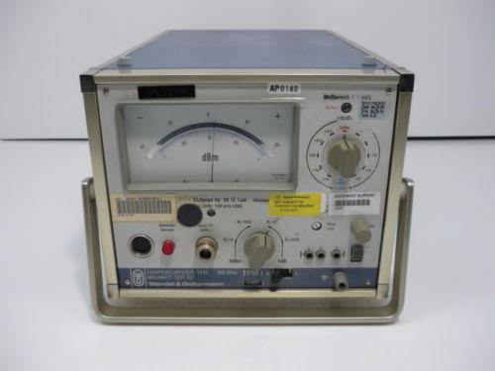
Wandel and Goltermann EPM-1
1mw power meter

Slide 9
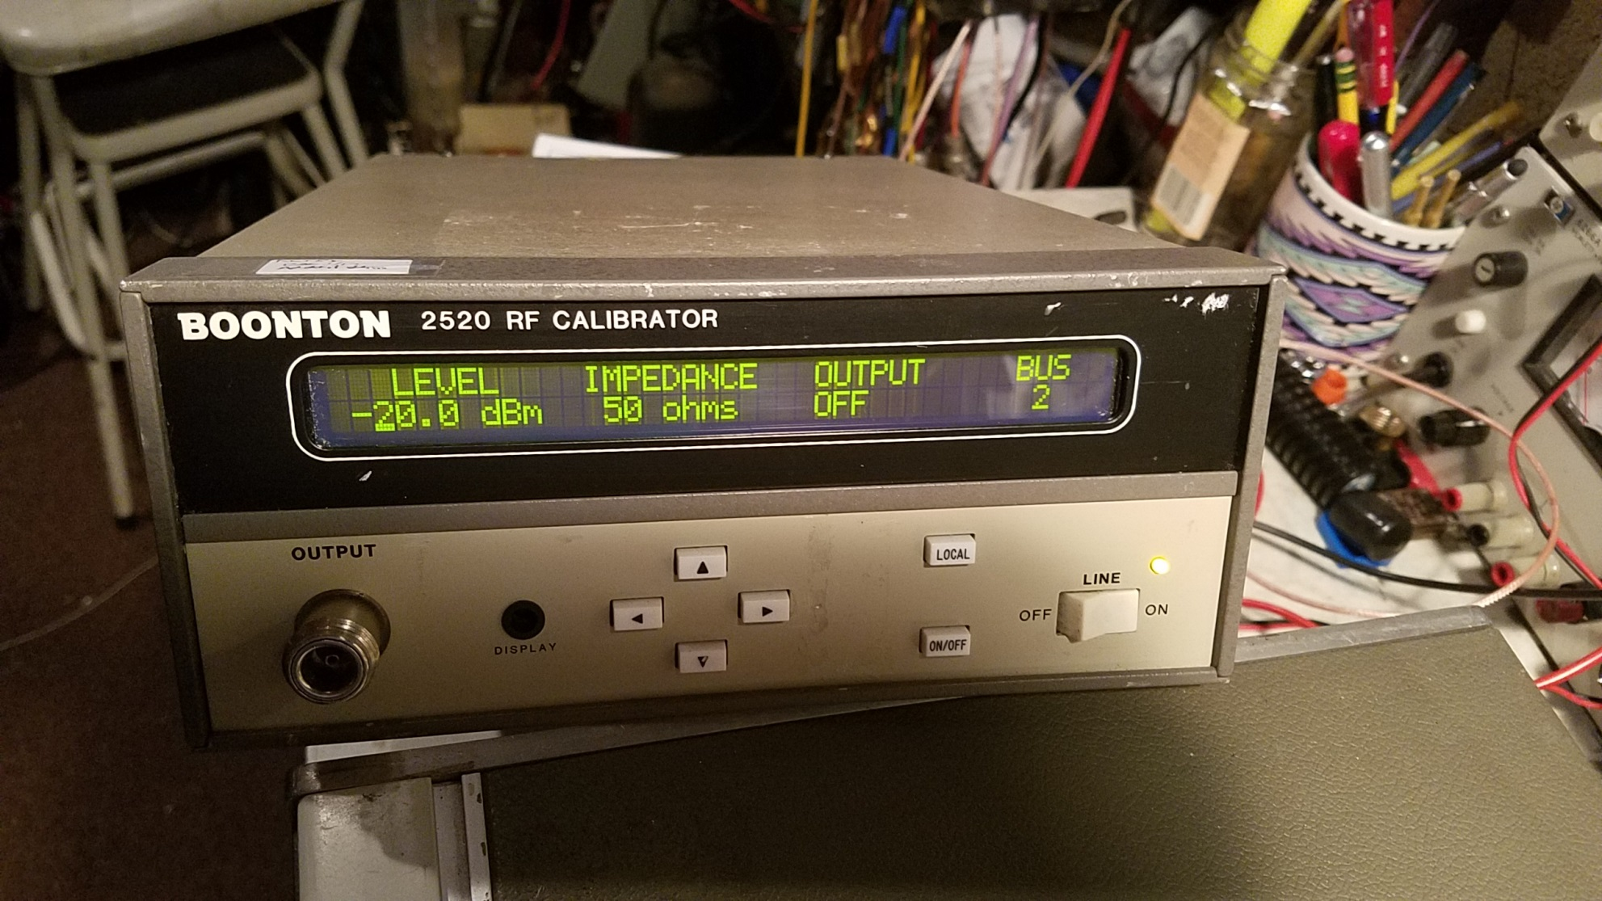
Boonton 2520- 30MHz, -70 to +20 DBm.
Accuracy is .05db

Slide 10
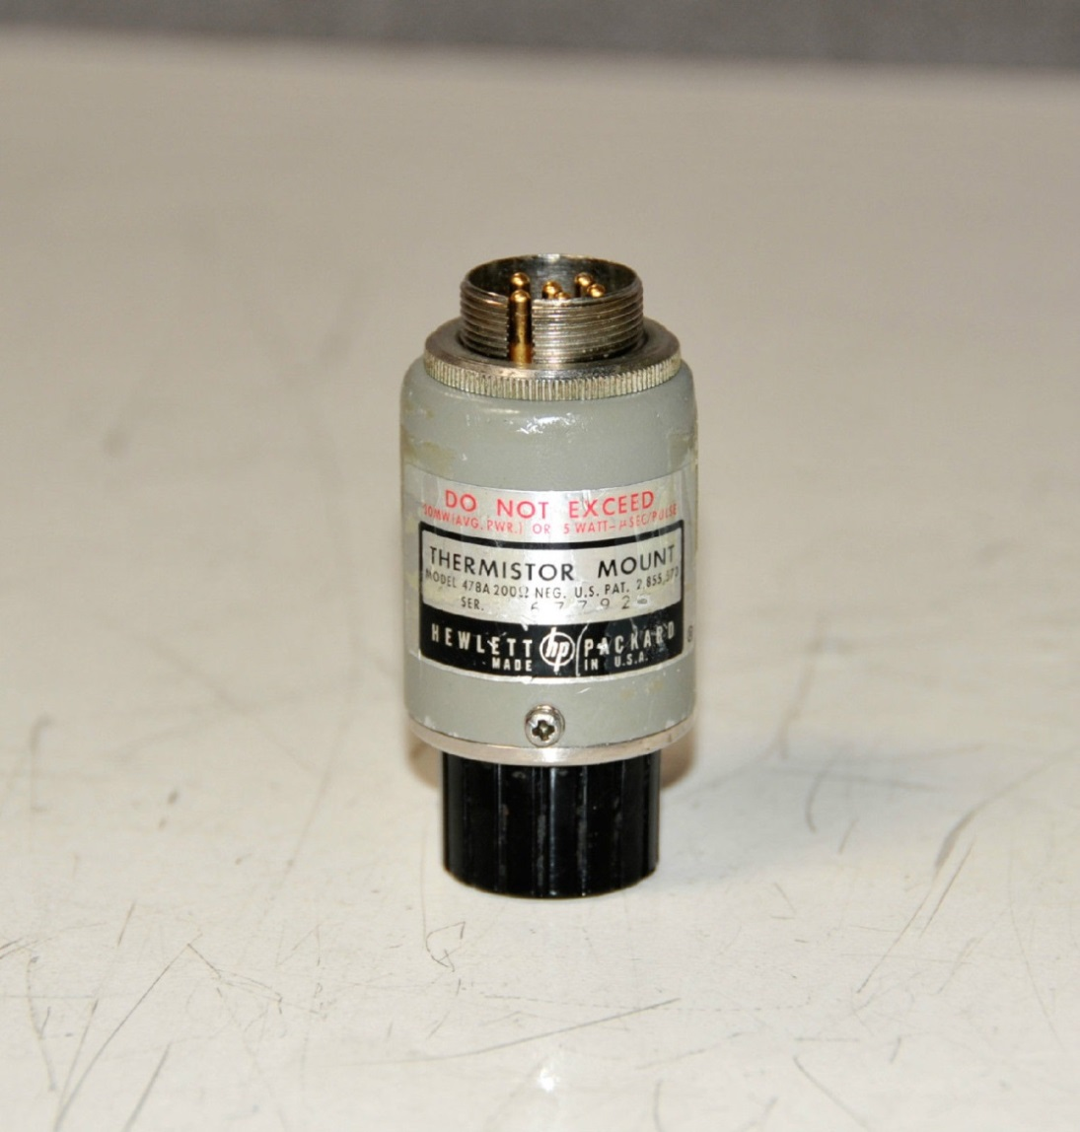
Lab standard at HP
Selected for low SWR. 10MHz to 500MHz
Used price $1,400 HP478-H75

Slide 11
My Lab Traceability
DC source calibration- HP34401A DVM Calibrated to .0002%
DC Power source- Valhalla 2700b
Transfer standard- PRD 685 Calorimetric Thermopile (1mw= 100uv)
  Power meter - HP 8482B sensor on an HP E4418b. In Cal
  RF Power source- Boonton 2520 RF power calibrator. 30MHz +20to -70DBM
Accuracy .05DB or 1.2%

Slide 12
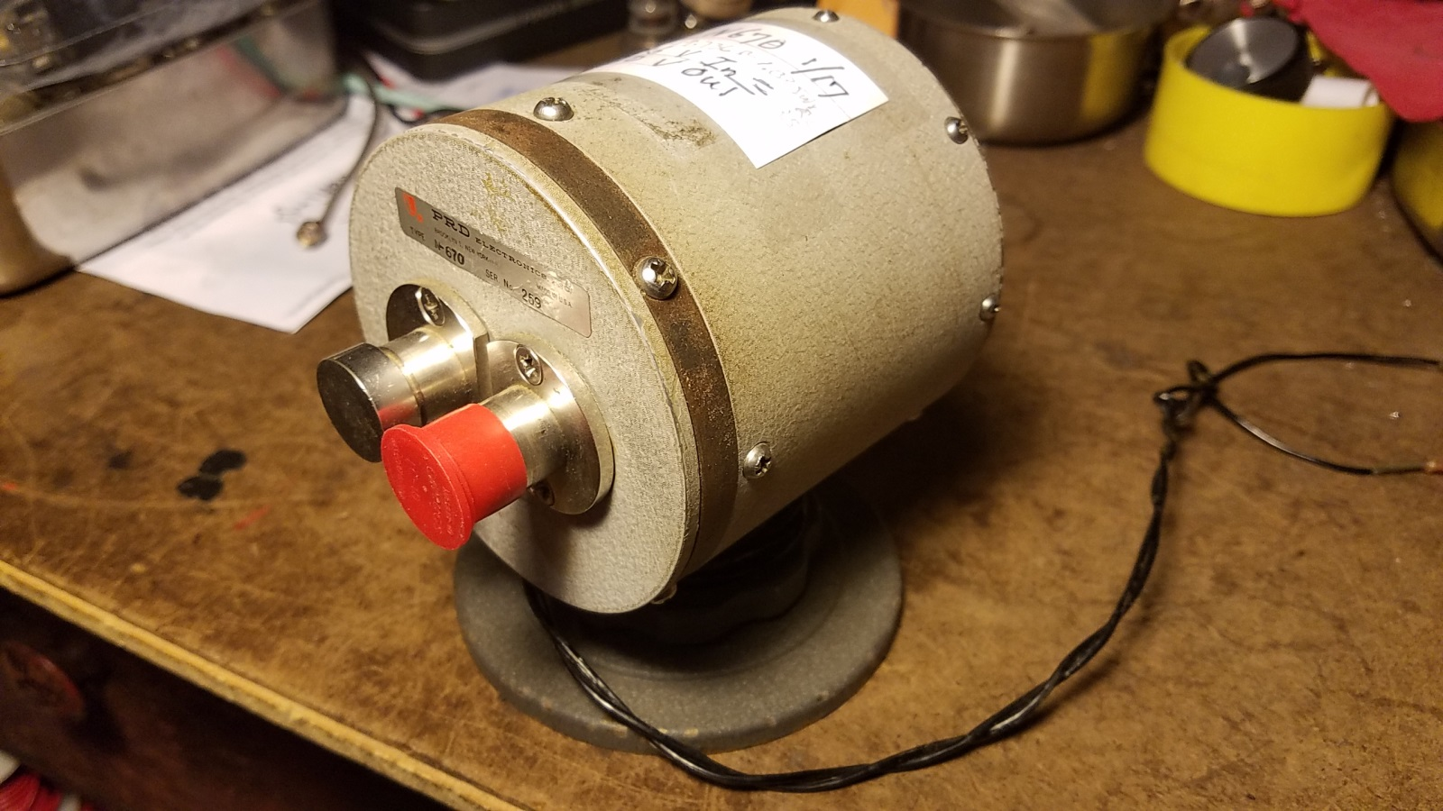
PRD 670 Thermopile
.2236v (1mw) input =
.1160v output

Slide 13
2520 Meter Calibrator Output
Cal output is .7% to 1.2% accuracy
Based on Standards lab equipment at Boonton
  Thermopile DC substitution
  Calibrated trombone attenuator at 30MHz
  In Cal if .988mw to 1.012mw- 1.2%
Far exceeds the measurement accuracy.

Slide 14
What are We Up against?
What is the list of uncertainties in measurement with a microwave power sensor?
What factors contribute the most?

Slide 15
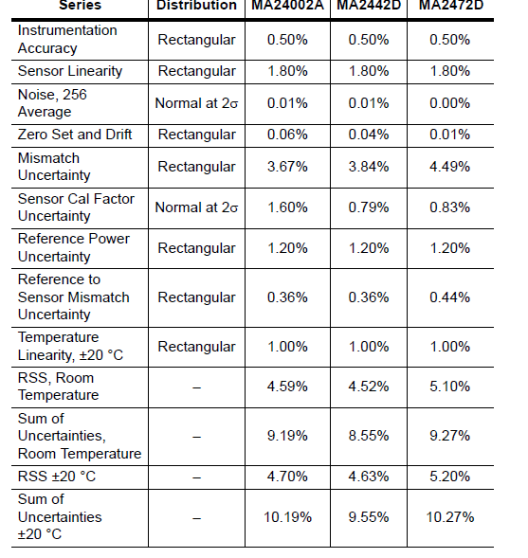
Sum of Uncertainties- Worst Case
The real problem -
3.8% mismatch?
--

Slide 16
HP 432 and
8478
Power Range
Vs. Uncertainty
HP 8481A
HP 8481D
E4412A EPROM
Sensor

Slide 17
Mismatch and Accuracy
The SWR of both the source and sensor have to be
Below 1.10:1 in order to add no more than .5% error to the reading. (20DB RL)
At 1.2 SWR the Inaccuracy is 1.5% (9DB RL)
Anything higher at either end due to any factor, and the inaccuracy skyrockets.
Sensor SWR and generator SWR are key to the accuracy problem.

Slide 18
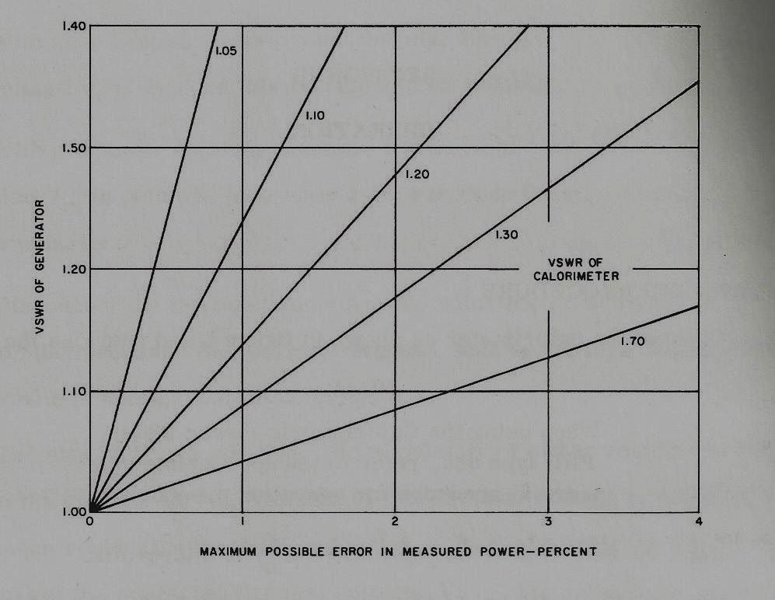
X= HP 436
And
HP8482A
x
Gen HP 8481B 1.2db Anritsu 2442A- 1.02db

Slide 19
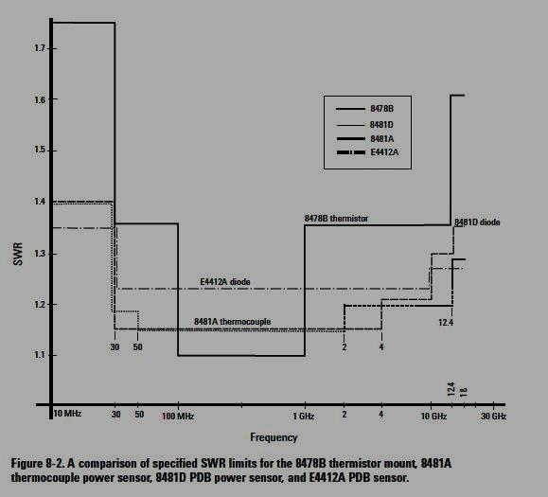
SensorSWR
Input coupling
Capacitor affects
Low freq. response

Slide 20
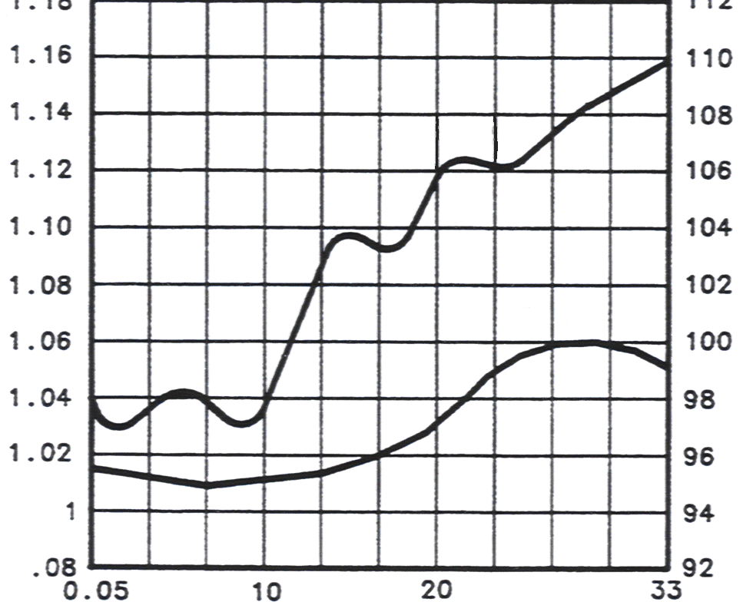
Cal Factor/SWR vs Frequency for HP 18 GHz Sensor
SWR
Cal Factor
SWR
Cal Factor

Slide 21
Accuracy Losses
0.5% Meter- fixed
4.5% Temperature- variable 1%?
1.8% Sensor Linearity- fixed
3.8% Mismatch loss- 1-2%
1.2% Calibrator calibration- .7% more likely
11.8% total uncertainty of reading worst case.
With some attention to detail, 6% is more like it.

Slide 22
Perspective
Modern meters like the E4418b/E4412a
  Use averaging through DSP
  Have stored factors in the sensor
  Compensate for temperature
  Use computers to characterize both the meter and sensor.
Modern meters may constrain the errors to 5%.
Meters like the HP 436 may do a pretty good job.
Note- dropping the sensor or applying too much power, even for a second, can completely change the sensor linearity and accuracy

Slide 23
Questions?
Thanks very much!

Slide 24
Clinic
Use your score sheet to measure
  Power Sensors with your meter
  Spectrum Analyzer attenuator linearity
  Attenuator value at 30MHz

Slide 25
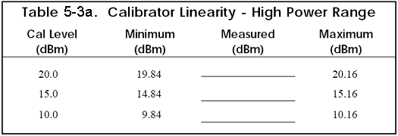
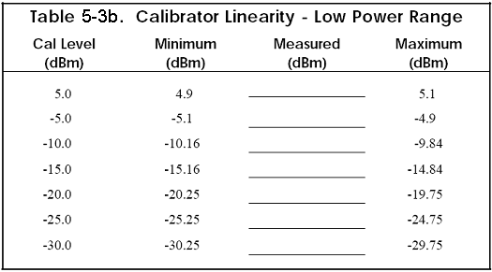
Sensor Linearity Record
.05db/1.2%

Slide 26
Resources
HP Application Note on RF Power Measurement
64-1C
PRD Calorimeter Manuals 680 series.
Anritsu manual on 2400 power sensors
  https://www.atecorp.com/ATECorp/media/pdfs/data-sheets/Anritsu-MA2400-Series_Manual.pdf

