Slide 1
A comparison of RF Power
Measurement Accuracies
Doug Millar
SBMS March 3, 2011

Slide 2
RF Power Accuracy
RF power measurement is made difficult because of the number of factors in measuring high frequency AC signals.
Detecting an RF signal level is not difficult , but turning that into a relatively accurate measurement of power is.
Doing so over a wide range of frequencies is even worse.

Slide 3
Diode Methods
Using a diode detector and a voltmeter calibrated in watts is the most common, whether it is in a coupler or directly sampled. These can measure very high levels of power, but roll off in accuracy fairly quickly. 10% OFS typical.
Diode systems need to be calibrated for frequency and power levels at frequent intervals. The meter inaccuracy also needs to be factored= K Factor and M factor.

Slide 4
Calorimetric Methods
If you measure the temperature rise in a fluid due to RF dissipation in a load, the power can be measured over a wide range of frequencies and levels.
Doing so requires simultaneous measurements of input and output temperature, fluid flow, input resistance and fluid density.
A calorimeter can be calibrated at DC.

Slide 5
Some Examples
The first example is a Bird 43 meter. A simple diode directional coupler that is accurate over a narrow frequency range and power level. Bird extends the range by extending the accuracy 5% vs 10% ofs.

Slide 6
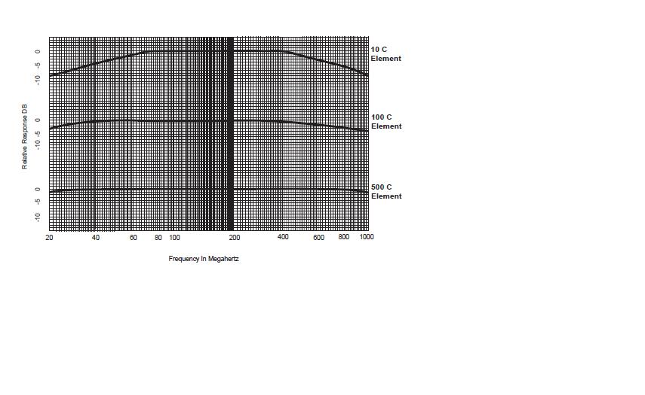
Error vs. Freq

Slide 7
Bird 43 Elements
Elements about 100 watts and up can be extended in frequency above and below their design frequency.
A 400 to 1000MHz element can be used on 1296 and will read between 5-10% low in power ofs. (25watts at 250w)

Slide 8
Termaline Meters
Bird Termaline meters have a capacitive voltage divider that feeds a diode and meter. Here are some diagrams.

Slide 9
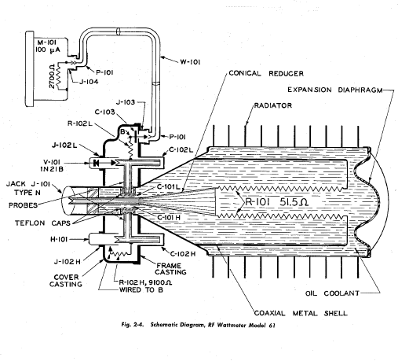
Schematic of a Bird 61

Slide 10
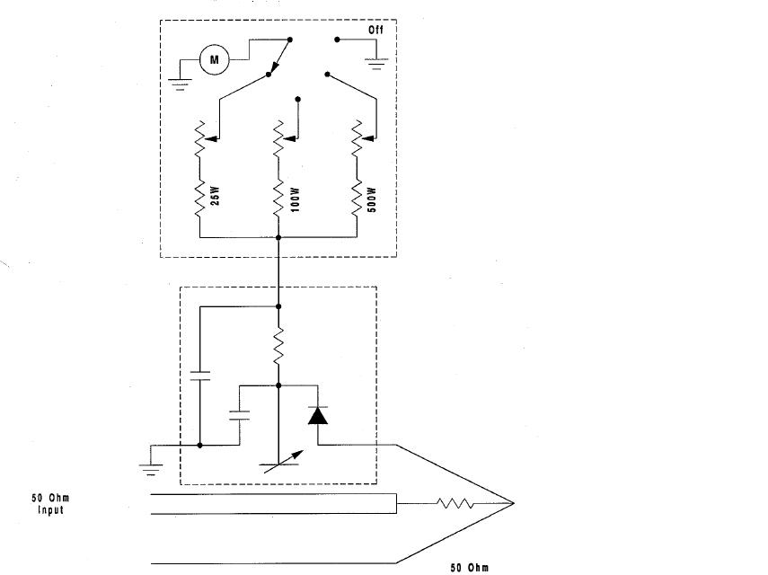
Schematic of a Termaline

Slide 11
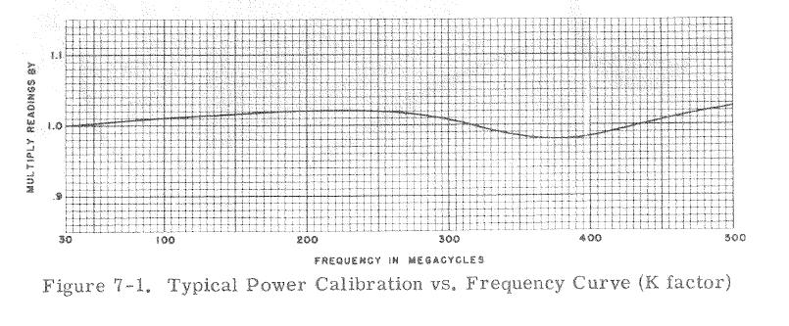
Termaline Freq. Resp.

Slide 12
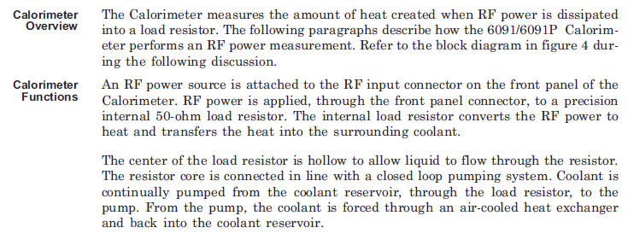
Calorimetric Theory

Slide 13
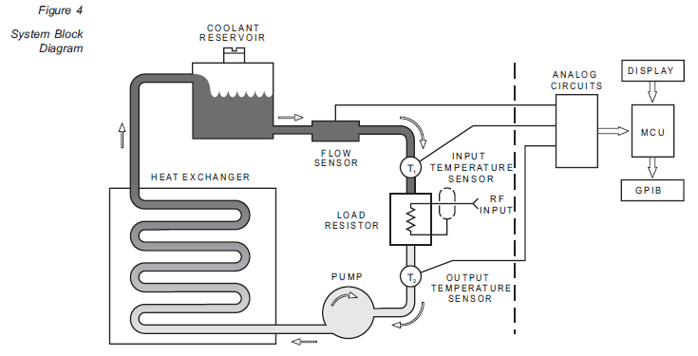
Bird 6091 Diagram

Slide 14
Calorimeter Disadvantages
Expensive/rare used.
Takes a fluid
Time lag of measurements dependent on thermal changes.
Not exactly portable.

Slide 15
Calorimeters
By measuring heat generated in a fluid for power measurements there are several benefits
Calibration can be done at DC since e2/r=w
Accuracy is largely dependent on load SWR and resistance.
Accuracies of 1.5% of reading can be had across the frequency range.

Slide 16
Other Meters
Bird 4410 1.5% ofs wider frequency range per slug and better accuracy. (Uses a Thermistor bridge)
MC Jones- cheap and cover wide frequency ranges. Also easy to change
Struthers/Douglas. Awkward but easy to calibrate.
Telewave- copy of Bird

Slide 17
Thanks
Contact info: drzarkof56@yahoo.com
Manuals for the Bird equipment listed are included on the SBMS website

Slide 18
Results
Have a primary source for power measurement you trust. Or just have one meter.
Know the limitations of the meter and use them.
The Bird 43 seems to be the best option for high power 23cm measurement.

