Slide 1
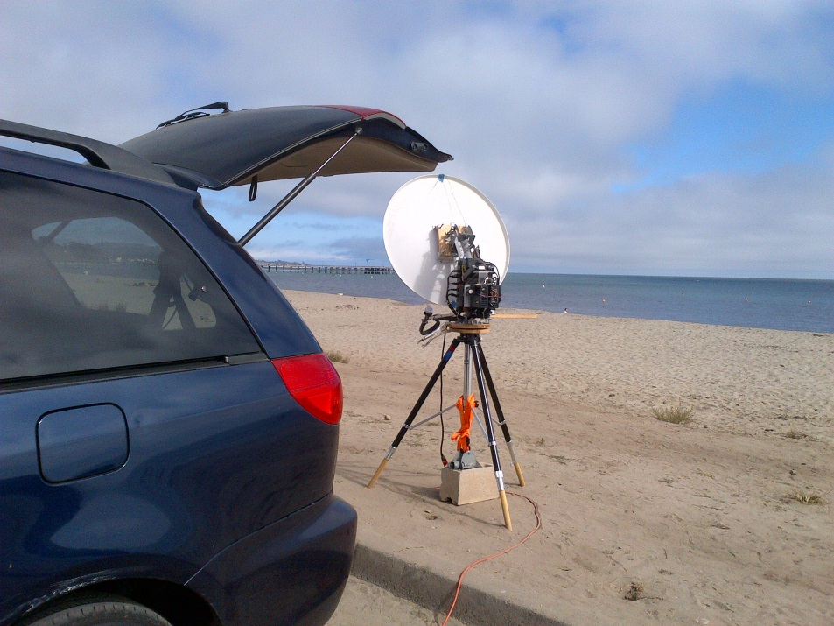
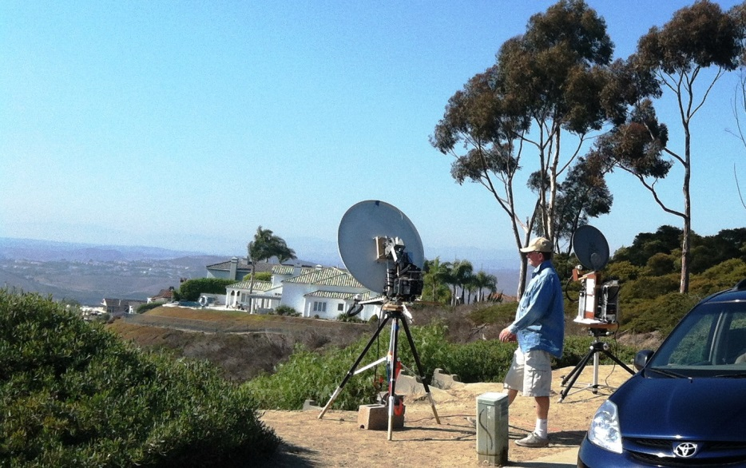
Entering The Exciting World of Amateur Ten GHz
Building an X-band transceiver with a little determination and a radio budget
Brian Thorson,
AF6NA
Past Vice-President SBMS

Slide 2
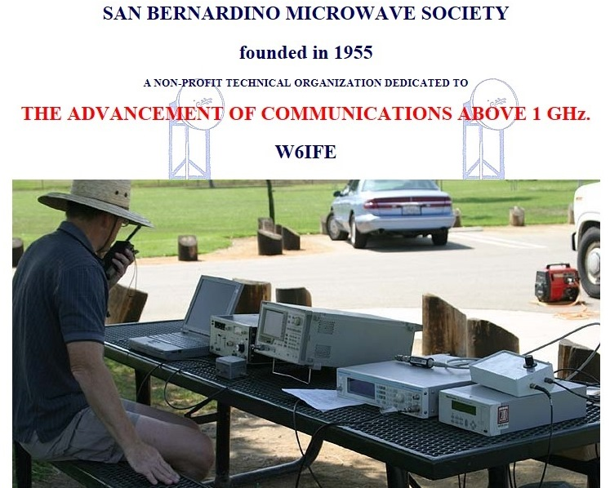
http://www.ham-radio.com/sbms
Meetings 1st Thursdays
7:00 PM – American Legion Hall – 1024 Main Street – Corona, CA

Slide 3
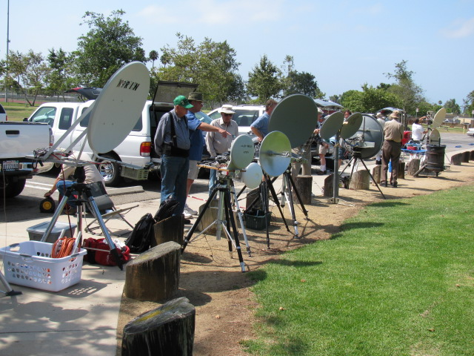
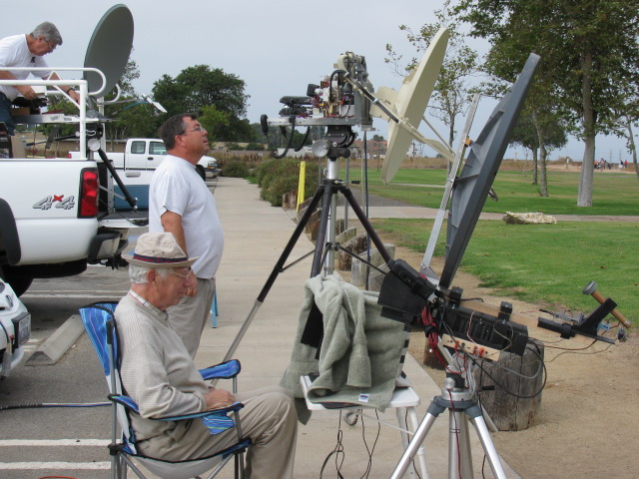
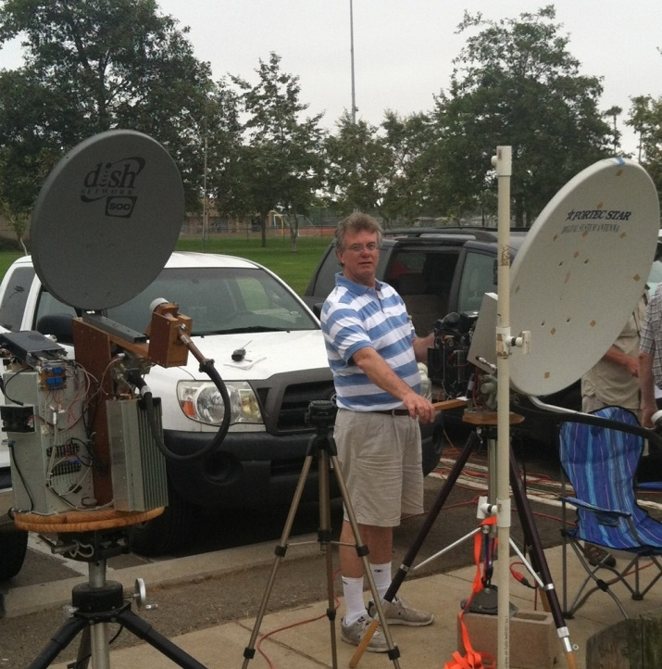
The Annual SBMS MW Tune-Up
Fairview Park, Costa Mesa, CA

Slide 4
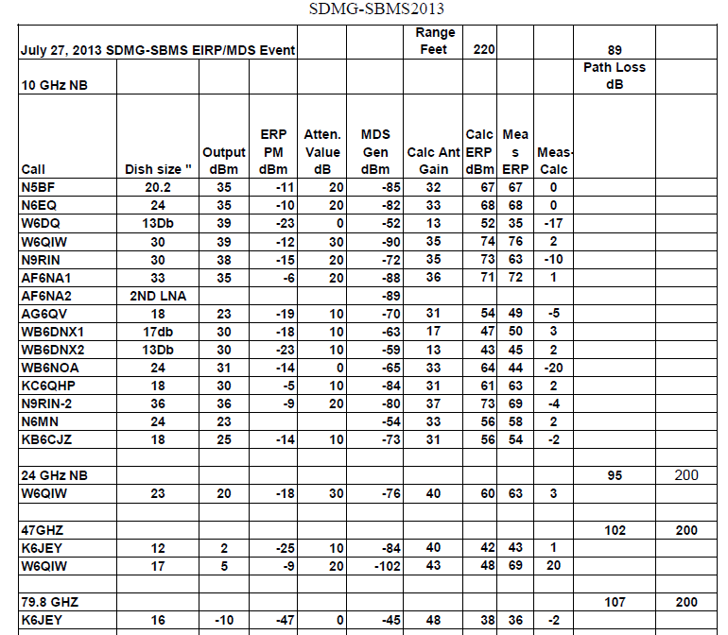
Microwave Tune-Up Results

Slide 5
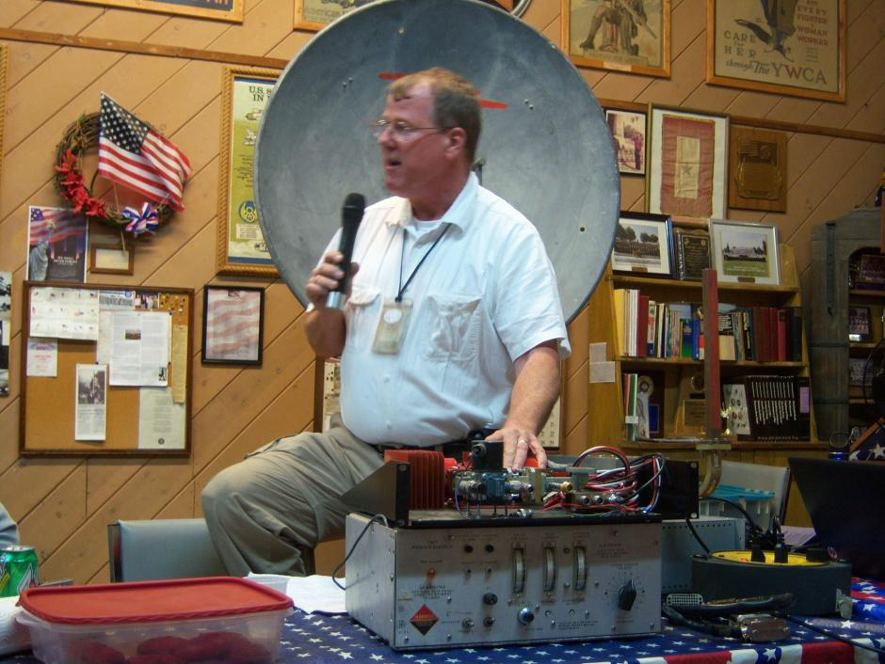
SBMS November 2011 Meeting
Mel, WA6JBD Talking about his 35 w 10 GHz TWT and its power supply at the November SBMS meeting.
System EIRP: +84.5 dBm (290 kW)

Slide 6
SBMS is an ARRL-Affiliated Radio Club.
Several SBMS Members have set
10 GHz distance records
Many SBMS members have been
ARRL Microwave Contest Winners
SBMS still holds the record for
the highest 10 GHz contest score.
Meetings On-line:
http://www.batc.tv/ch_live.php/atv repeaters/W6ATN

Slide 7
The Thrill of Microwaving
10 GHz means ten billion cycles per second. A billion is hard enough to comprehend in dollars or other quantities. But at “X” and other microwave bands,
the physics of electromagnetics is a bit different. Hollow tubes (waveguides) are the best transmission lines, and antennas take on unusual shapes.
Making a QSO is a very special event.

Slide 8
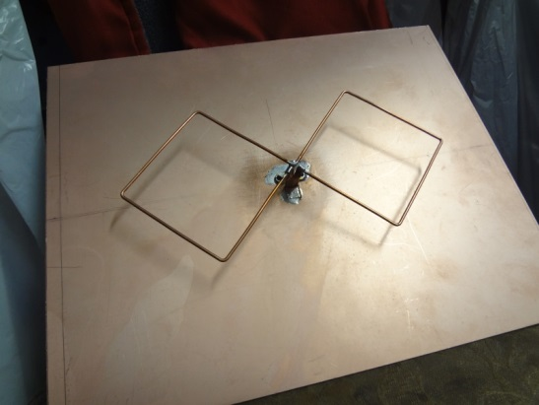
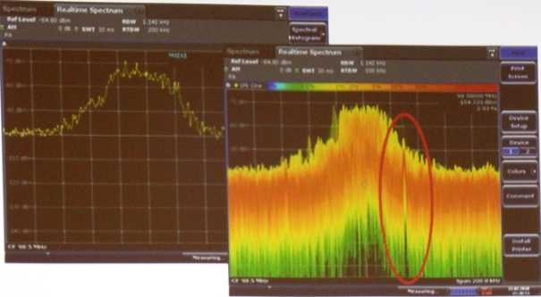
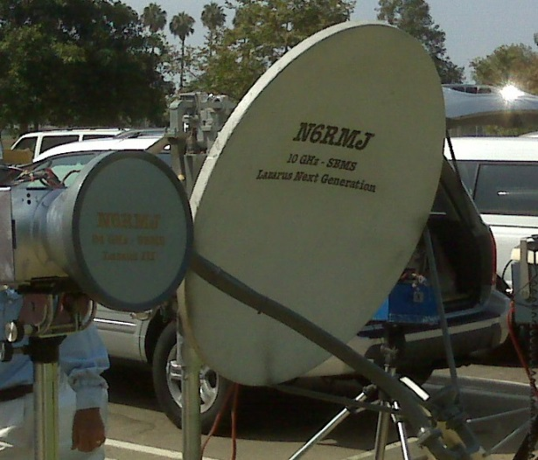
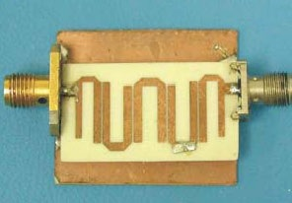
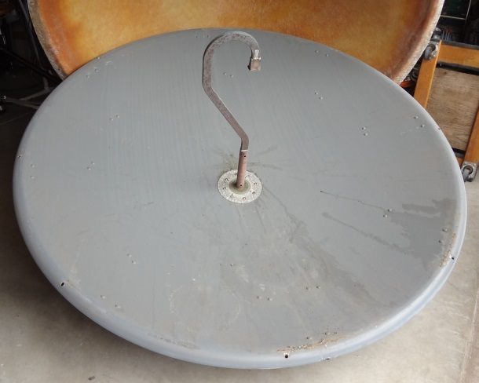
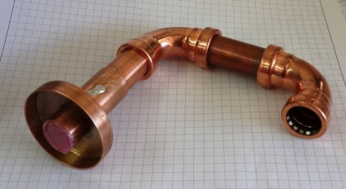
Microwave Stuff

Slide 9
Amateur Microwaves
33 cm 902.0-928.0 MHz:
23 cm 1240-1300 MHz
13 cm S-Band: 2300-2310 MHz; 2390-2450 MHz
9 cm C-Band: 3300-3500 MHz
6 cm C-Band: 5650-5925 MHz
3 cm X-Band: 10.0-10.5 GHz <<< !!
K-Band: 24.0-24.25 GHz
V-Band: 47.0-47.2 GHz
W-Band: 76.0-81.9 GHz*
119.98-120.02 GHz
142-149 GHz
241-250 GHz
Above 300 GHz
*76-77 GHz has been suspended temporarily
Notes:
For those of you who are a little bored with Ham radio, you’ve been there, done that ...
THERE’S MORE!

Slide 10
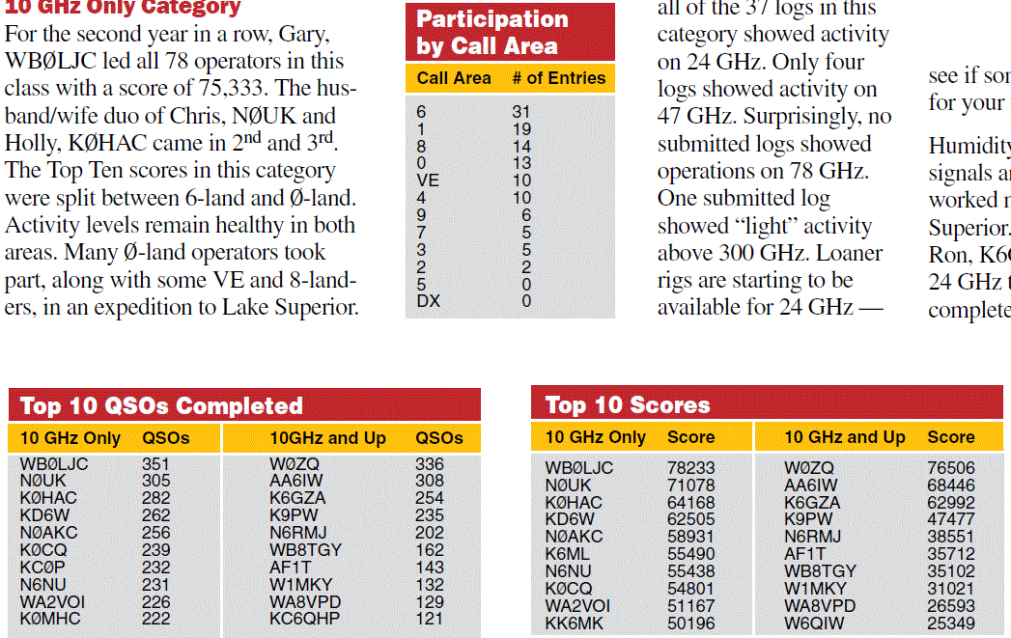
2012 Contest Results

Slide 11
Your Next Project?
This could be the next challenge for some of you Hams with some experience but who are looking for a new avenue or thrill in Amateur Radio!

Slide 12
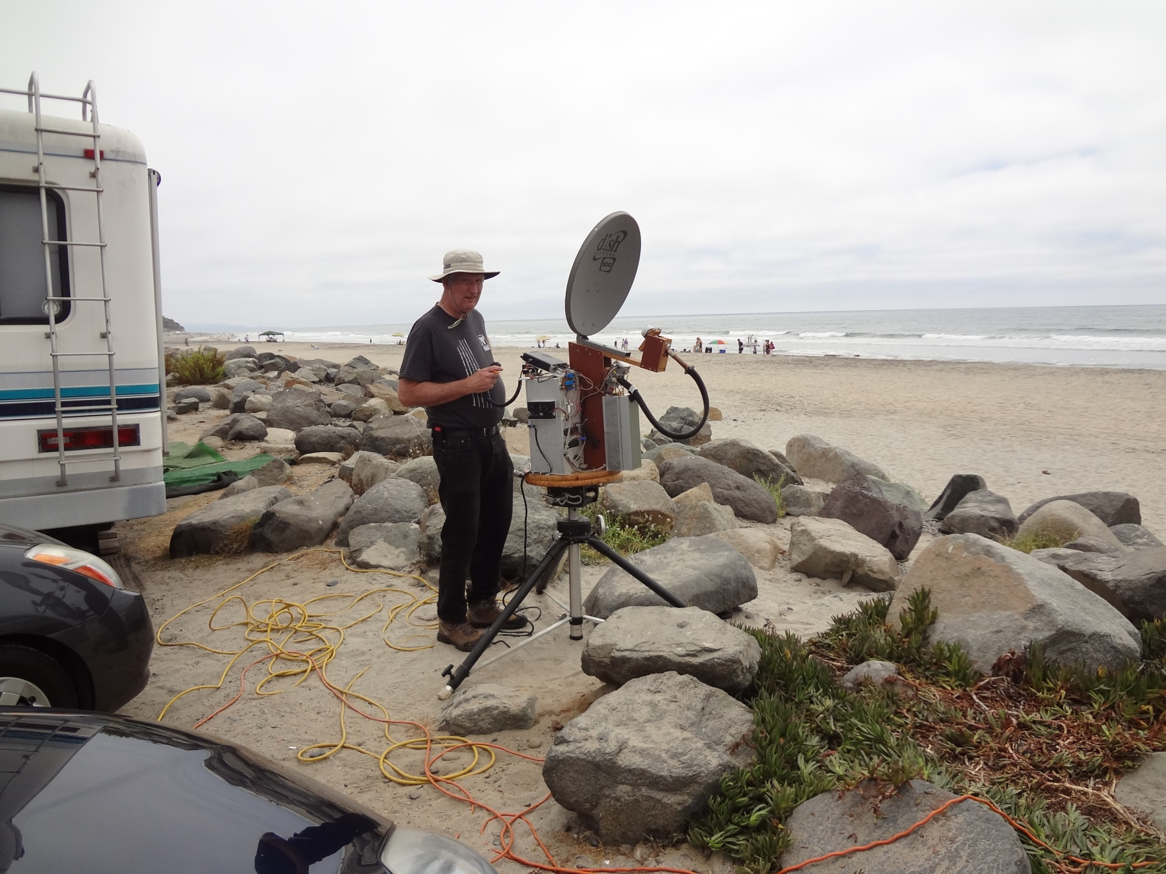
N5BF “X-Banding” at Solana Beach

Slide 13
How to explain your (very) “geeky” activity
“Do you have a 4G phone? … Well, this is 10G.”
“We are searching for whales in migration.”
“I wish you wouldn’t ask me questions like that, I may have to call the FBI.”
“We are X-banding.”

Slide 14
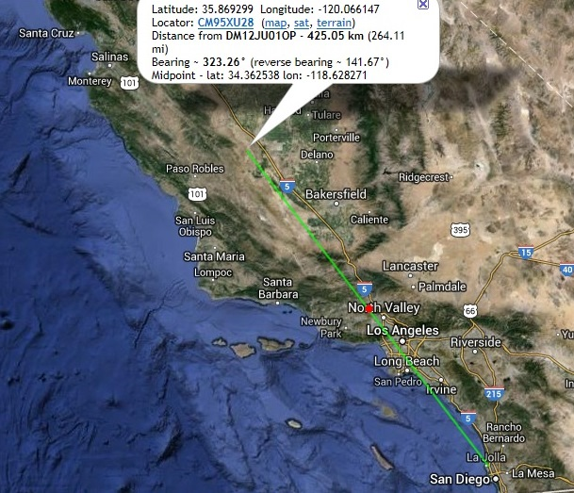
A Recent X-Band QSO
San Diego (DM12JU) to Avenal on 3W at 10368.425 MHz- 426 km

Slide 15
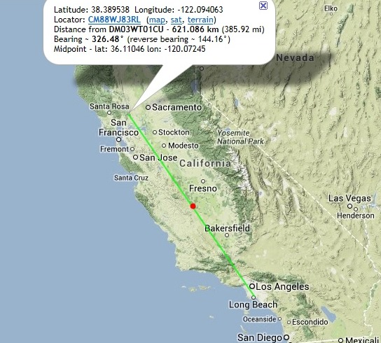
My Longest X-Band QSO
Signal Hill (DM03WT) to Mt. Vaca (CM88WJ) – 623 km (386 mi.)

Slide 16
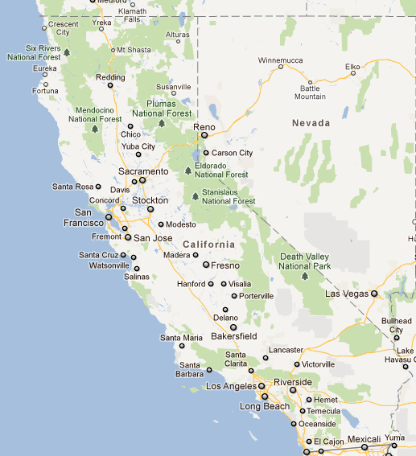
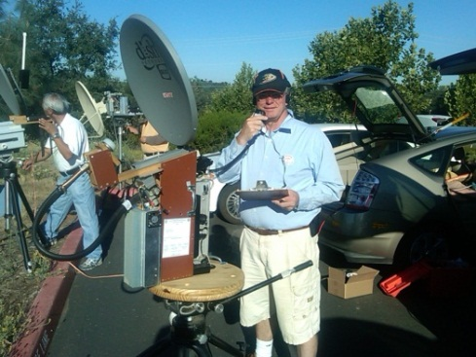
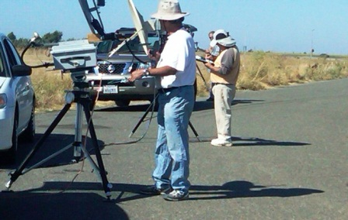
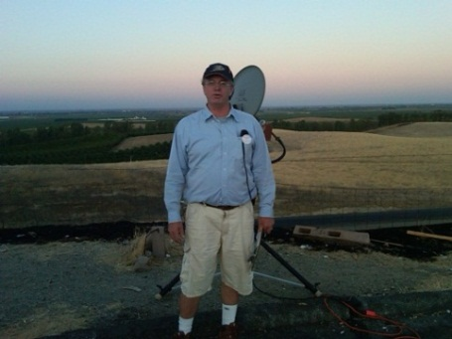
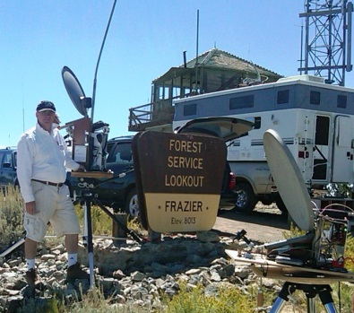
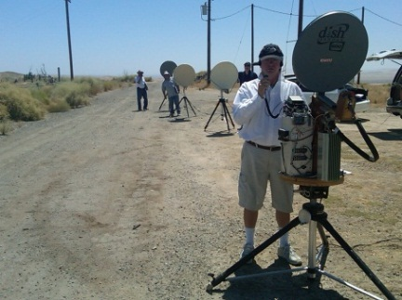
The 2011 ARRL 10 GHZ and UP Contest: AF6NA - 40,674 Points – 7th Place in the U.S.
Placerville
Walnut Grove (I-5)
Los Banos (I-5)
Frazier Peak
Avenal
Corona (Home QTH)
Mt. Soledad, San Diego

Slide 17
LINE-OF-SIGHT ??
Hey, isn’t microwave just
“line-of-sight” communications?
YES and NO
How did I work Mt. Potosi in Las Vegas from Los Banos, CA, (529 km)
shooting over the north slope of Mt. Whitney,
the tallest peak
in the contiguous 48 states ???
It’s in my log. WA6JBD and WA6CDR

Slide 18
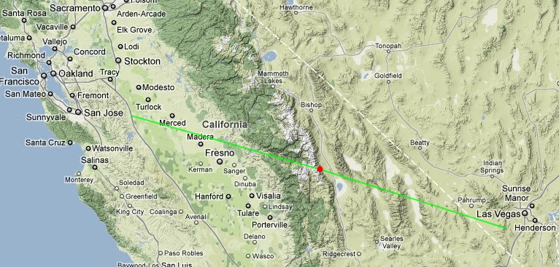
Over Mt. Whitney
Los Banos to Mt. Potosi – 529 km (329 mi.)

Slide 19

Microwaves Over Mt. Whitney??!!
14,497 feet
V

Slide 20

10 GHz World Record: 2696km
(Almost 1700 Miles)
Set July 10th, 2010 by Swiss “Hyperatlantica” Team
Cape Verde Islands to Portugal

Slide 21
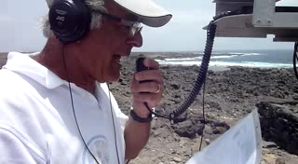
HB9AZN, Pierre-Andre Probst

Slide 22
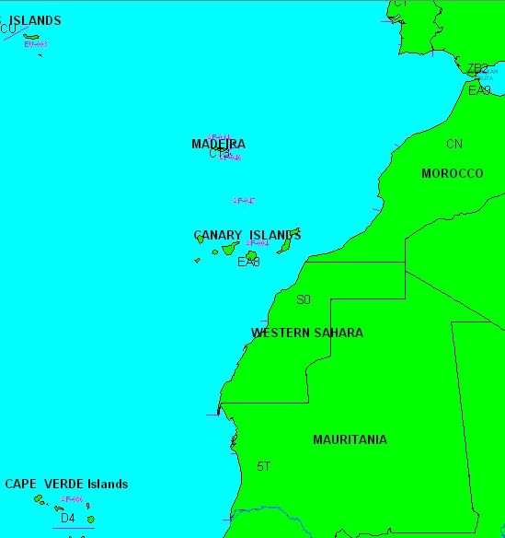
Planification
Trafic avec les partenaires CT / CN / EA8 / CT3
2079Km ancien record

Slide 23
How Do I Get Some of This 10 G Excitement?
The B.Y.O.R. Method

Slide 24
“Build Your Own Radio” (BYOR):
An Amateur Radio Tradition
Building a radio from available parts is one of the greatest of Ham radio traditions.
Microwave amateur radios are not available off the shelf from any manufacturers.
This is really one of the most rewarding parts of becoming a microwave ham.
No two radios are exactly alike, they all have their own design, shape factor, performance specs, strengths and weaknesses.
Start with what you already have..

Slide 25
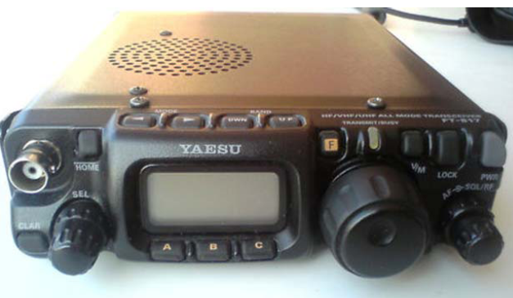
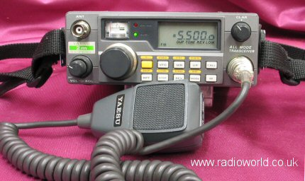
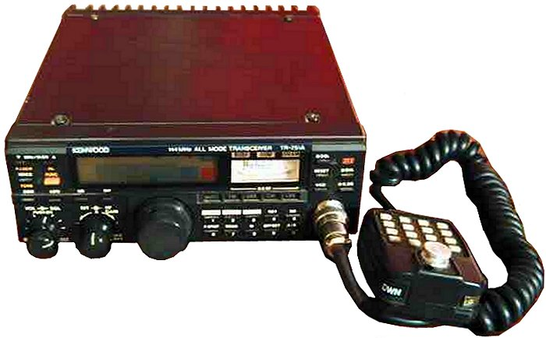
A “QRP” Radio
Most amateurs have a “QRP” radio, that is, a low-power radio. The Yaesu FT-817 is a great unit and many experienced microwavers prefer it as an “IF” radio
144 MHz “IF” radios:
Yaesu FT-290 MKII
2M (144 MHz)
Kenwood TR-751A
2M (144 MHz)

Slide 26
A “QRP” Radio
From Tom Curlee, SBMS
TR-751 - $250.00
FT-290R - $100.00
Repair units - $100.00

Slide 27
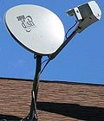
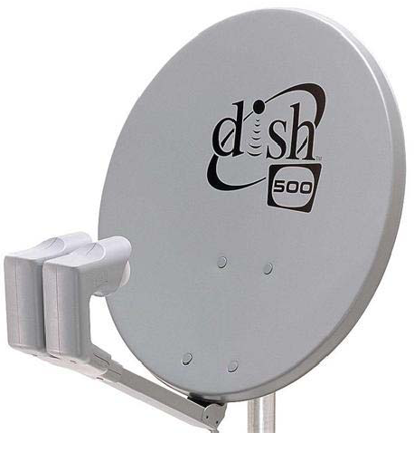
An abandoned DBS or FTA dish
Many people have an old satellite dish they no longer use, such as a Dish Network or DirecTV dish attached to the side of the house.
Try to find one with the feed assembly in place.
That way, you don’t have to do so much math to find the focal point.
$ FREE !!

Slide 28
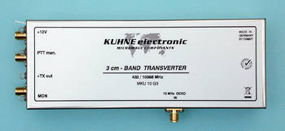
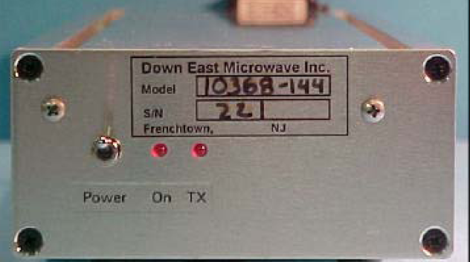
Next, get a “transverter”
A transverter is the heart of the system.
DB6NT from Kuhne Electronics GMBH
280mW / 1.2 dB NF …About $650 US plus shipping from Germany
http://www.kuhne-electronic.de/en/products.html
Down East Microwave (DEMI)
3W/1.5 dB NF ………….. $775
http://www.downeastmicrowave.com/

Slide 29
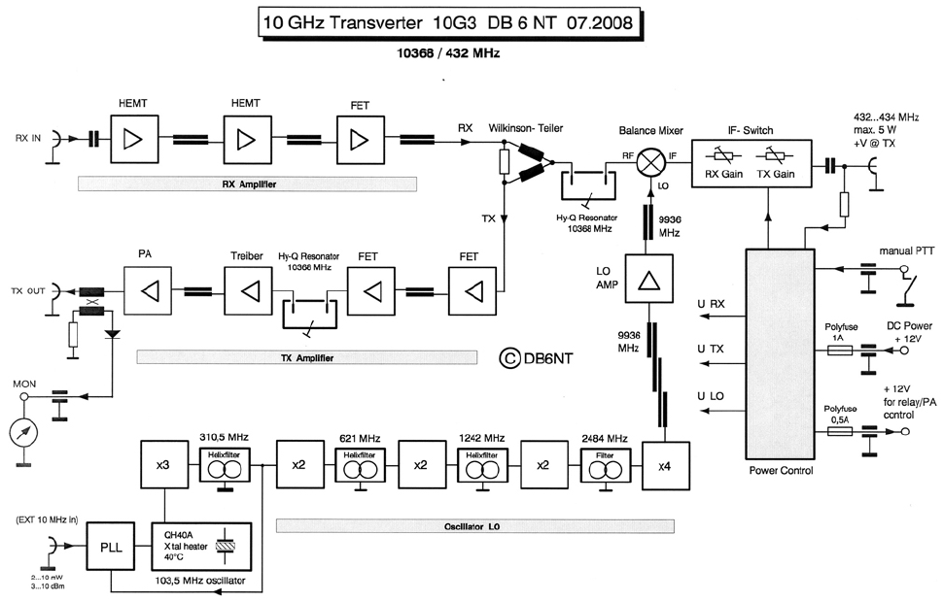
From 2M or 432 MHz to 10 GHz:

Slide 30
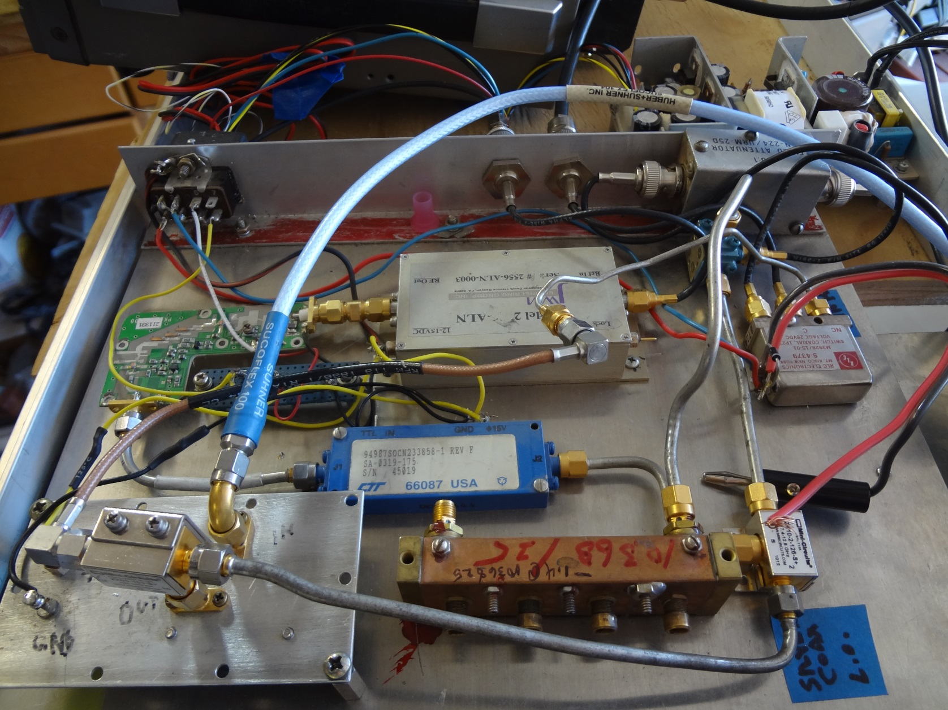
A 10 GHz Transverter From Parts

Slide 31
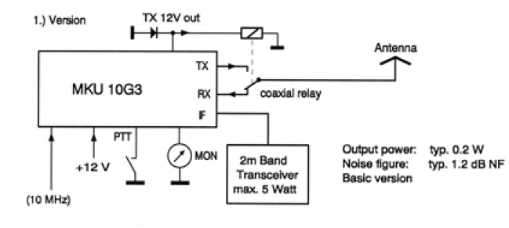
A Microwave System Plan
A simple 280 mW radio will make many QSOs (DB6NT based system shown)

Slide 32
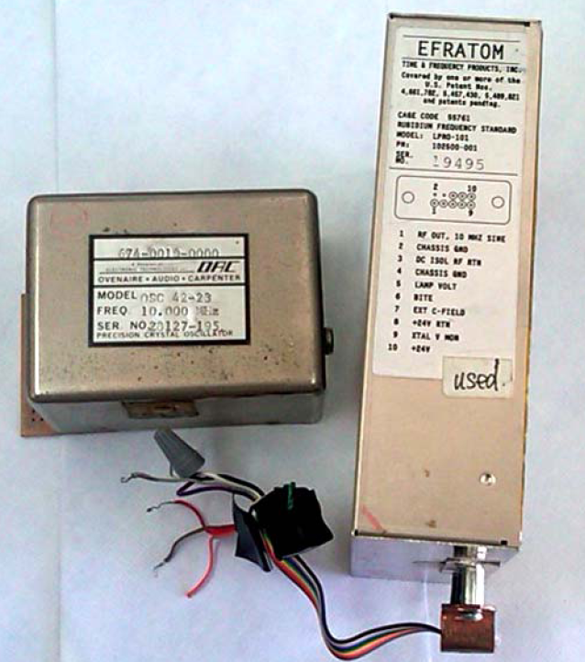
Frequency Stability
A high stability “master oscillator” will be necessary to tune in SSB signals at X-band.
A Rubidium or “Rubi” and an OCXO are shown
$ 99.00 on eBay

Slide 33
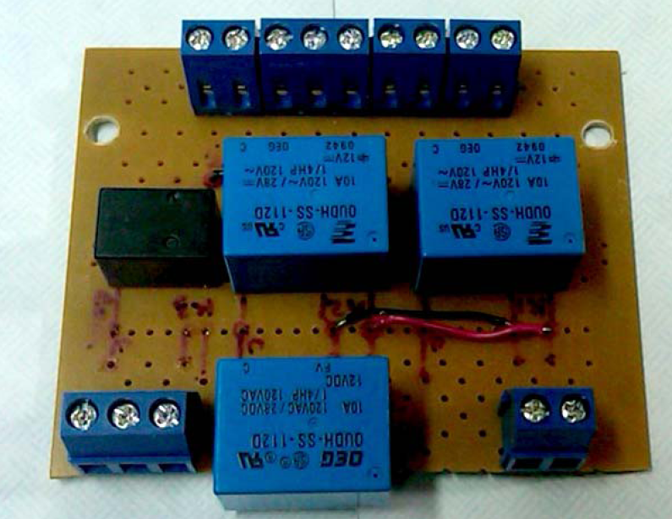
An Interface / Sequencer
Getting the transverter, the T/R switch, the cooling fans, (power amp), and everything to switch on when you press the “PTT” button may take a little creativity and electronic design.
I used relays from
Radio Shack
Solid State
Sequencers are
available

Slide 34
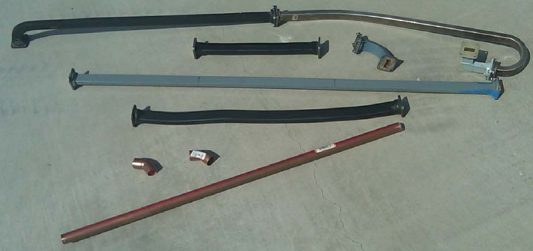
Microwave Plumbing
Waveguide is the best transmission line for the microwave bands. WR-90 is the best for 10.368 GHz. (3/4” copper pipe)

Slide 35
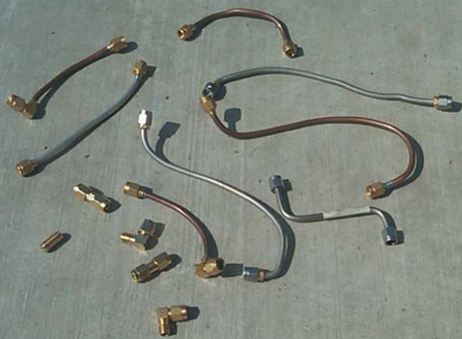
Microwave Coax
‘Semi-rigid’ coax, such as UT-141T, is rated for microwave frequencies, but is more lossy than waveguide.

Slide 36
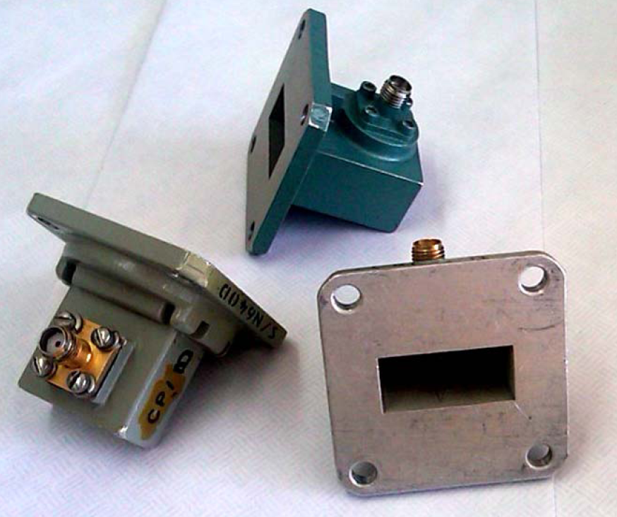
WR-90 to SMA Transitions
Waveguide-to-Coax transitions are used near the
Antenna feed
point to convert
from coax to the
waveguide so the
microwave power
can be applied to
the reflector.

Slide 37
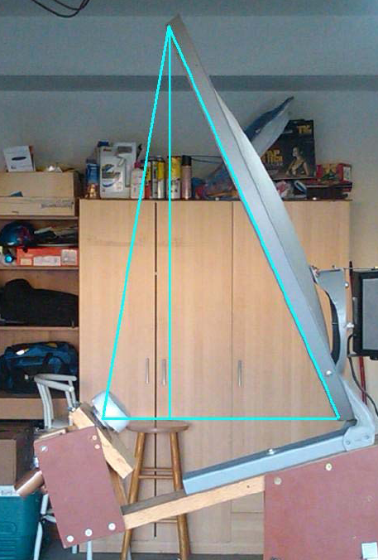
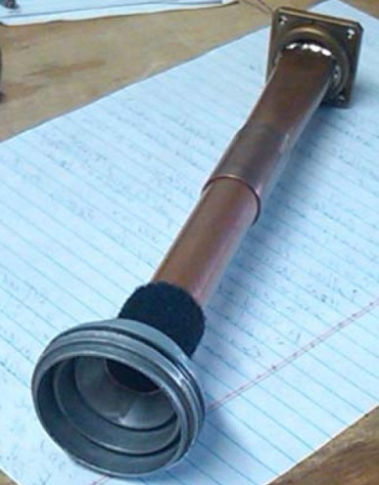
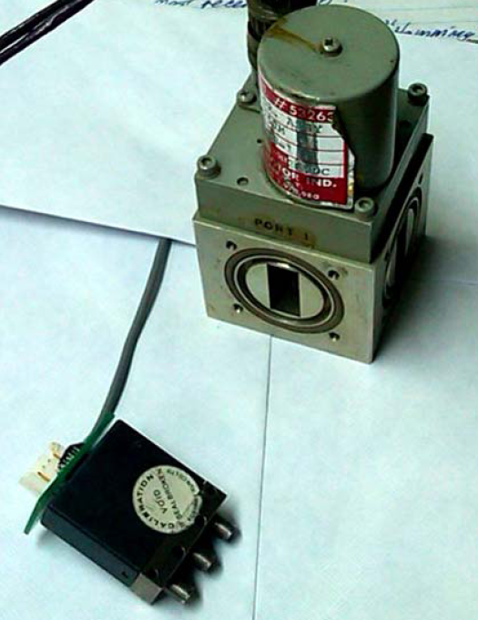
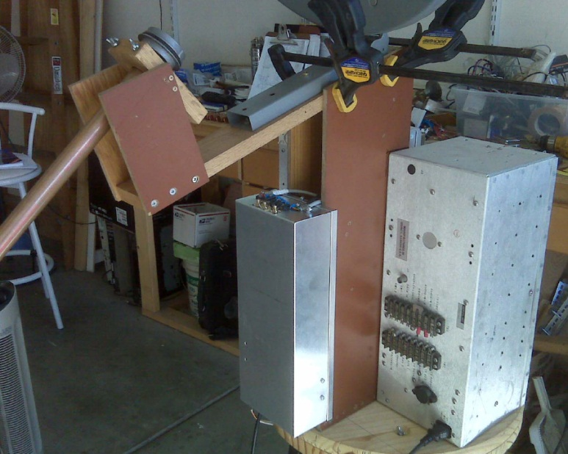
Assembling the Parts
Feed Horn Assembly
T-R Switching
Antenna focal point
D.C. Supplies

Slide 38
Power Loss: The Microwave Challenge
Microwaves are a very “elusive” quantity - losing half a dB here and a dB there in a microwave system is very easy to do.
Use the best semi-rigid coax and the shortest lengths possible.
Avoid getting “kinks” in the semi-rigid, and dents in the waveguides.
Losses on the receive side can seriously affect your minimum discernable signal (MDS).

Slide 39
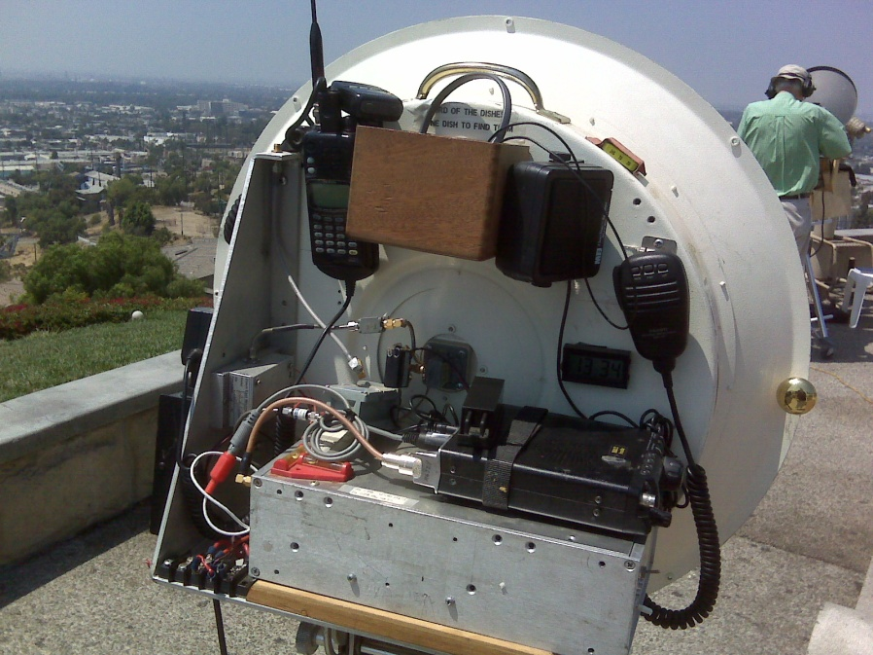
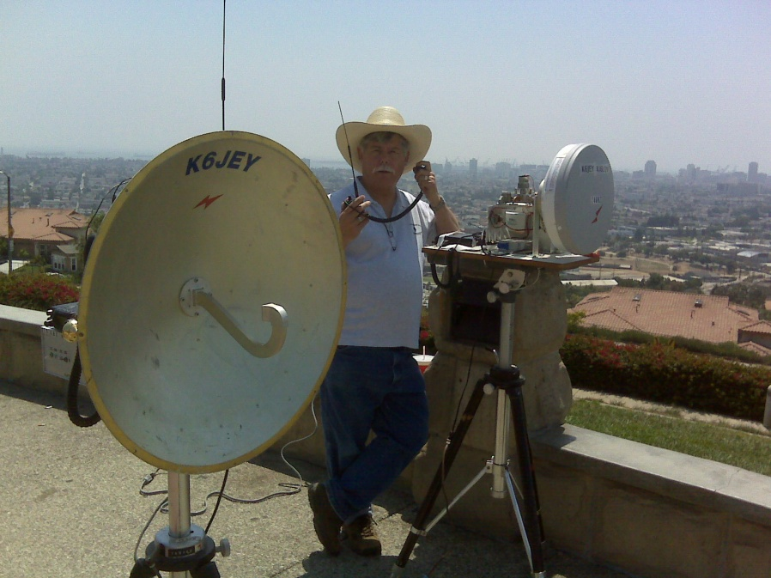
Close To The Dish
To minimize power losses, microwave frequency components should be located as close to the reflector feed as possible.
K6JEY has a great example of this.
Doug Millar, PhD., K6JEY

Slide 40
Focus on the focus
Your best time investment will be spent getting high efficiency out of the reflector antenna and feed system.
The lowest cost and lowest noise gain you have in your microwave system is your antenna. If you take care to put the feedhorn at the right spot and point the feedhorn correctly, your antenna gain will be maximized and noise minimized.
If you just “rough it in” the antenna will perform poorly. The receive system will be noisy, making it hard to receive weaker signals and expensive microwave Watts will be wasted.

Slide 41
Focus on the focus
Getting the focus and feed angles correct will take a bit of geometry and algebra.
Paul Wade, W1GHZ, has done extensive research work into microwave reflector antennas and has published excellent tutorial material on his website:
http://www.w1ghz.org/antbook/contents.htm
Additional information on offsets and feeds is also helpful.

Slide 42
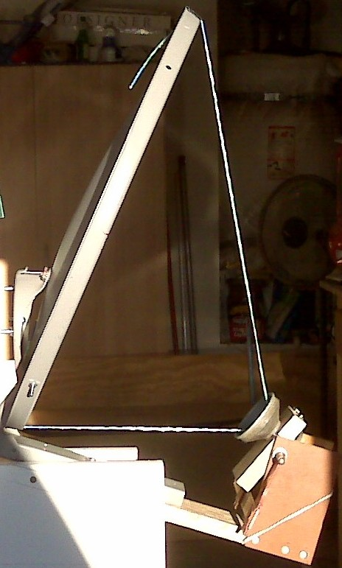
Focus on the focus
W1GHZ developed a very useful method of finding the focal point with a string.
The string is marked with the calculated values of focal length and illumination angle

Slide 43
Offset Reflector Geometry
When making measurements on your dish, measure to the edges of the reflective surface, rather than the outside lip of the sheet metal. This will yield better agreement with calculated values.

Slide 44
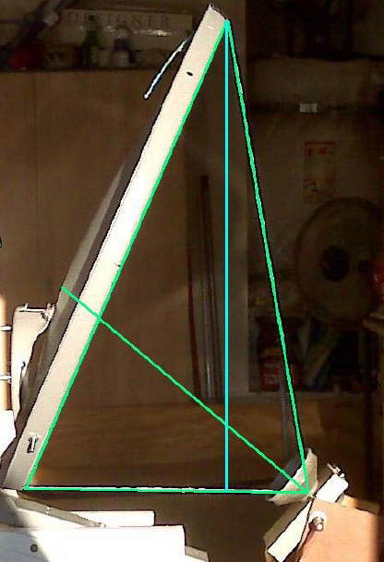
Pointing the Feedhorn
Bisect the offset reflector vertical illumination angle and that’s the spot to point at, not the center of the reflector.

Slide 45



Focus on the focus
My latest Offset:

Slide 46
A Word About “Tinkering”
Assembling and de-bugging a microwave radio is a very time-consuming and gratifying activity….
…. So much so, that some Hams have turned it into a multiple-year project, and some haven’t finished yet!
The Goal: GOTA!

Slide 47
Well-Built Radios
A well-built microwave radio is one that works well not only in the lab, but has been ruggedized to take a car ride all weekend and not fall apart en-route.
Should be able to arrive at a roving location and be on the air in less than 10 minutes.

Slide 48

Examples of Well-Built Radios
Steve, W6QIW: Close to the Feed

Slide 49

Examples of Well-Built Radios
John, KJ6HZ Has all parts on one plate

Slide 50



The SBMS Microwave Tune-Up
Every year on the last weekend of July
Fairview Park, Costa Mesa, CA
EIRP and MDS measurements

Slide 51




The Big Event:
ARRL 10 GHz and Up Contest

Slide 52
What’s A Ham To Do?
  Attend SBMS meetings and get acquainted
  GOTA – Get On The Air with a 10 GHz Rig
  Make it ‘rugged” enough to withstand a ride in your car / truck, etc.
  Partner with another experienced and successful operator for the contest
  Try it before you say it can’t be done

Slide 53
Questions? help is available from SBMS members
SBMS Web Site http://www.ham-radio.com/sbms/
Meetings every 1st Thursday of the month
7:00 PM
The American Legion Hall
1024 Main Street
Corona, CA

